Slide 1

Measuring the wetting properties of cyclopentane hydrates
Fanny Thomas¹, Jeffrey Morris¹ and Didier Dalmazzone²
¹ The Levich Institute and Department of Chemical Engineering,
The City College of New York
² ENSTA ParisTech, Unité Chimie et Procédés
PIRE Annual Review Meeting
June 17th, 2019
Research Thrust 2: Formation and Control of Gas Hydrate Slurries

Slide 2
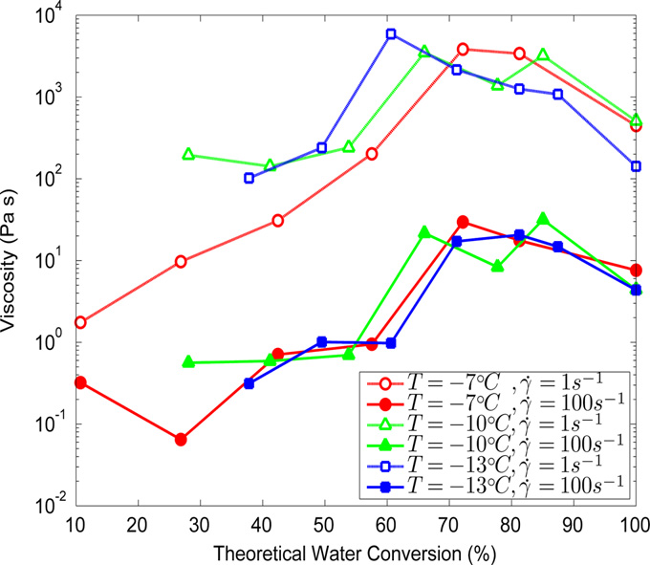
Motivation
The crucial role of wetting and capillary forces
0% conversion – Water-in-oil emulsion
~70% conversion - 3-phase system
100% conversion - Suspension
Zylyftari et al. Chem. Eng Sci. 2013
Knowledge of the interfacial energy between hydrates and oil-field liquids is of great importance

Slide 3
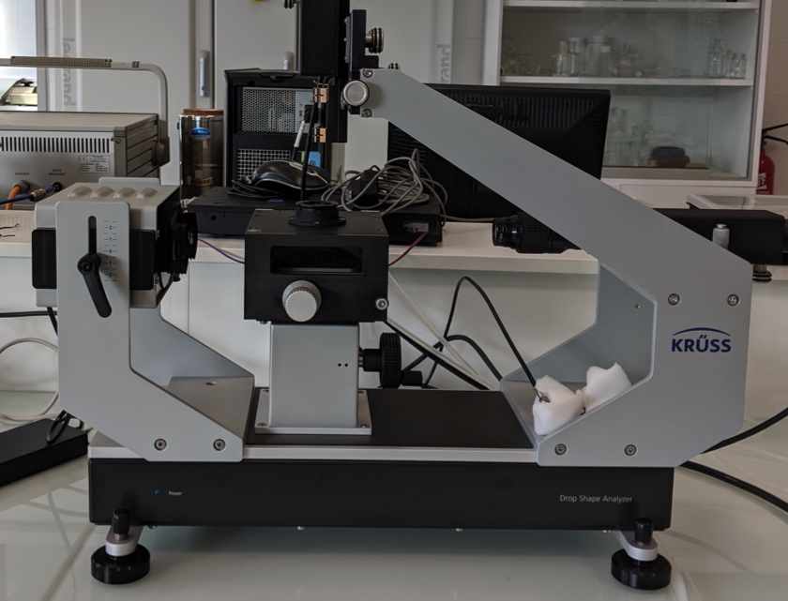
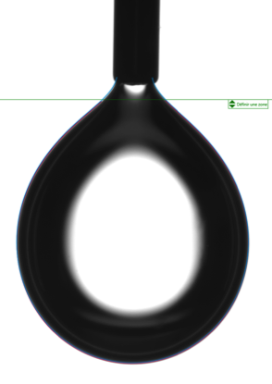
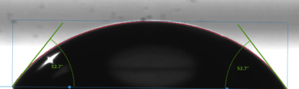
Methods
Initial plan
Hydrate layer
Rigid, flat and smooth layer
Slow growth
As few crystals as possible
Droplet deposition
Contact angle
CP
CP
DI Water
Water
Measurement methods
Experimental setup
Surface properties measurements:
Pendant drop method for interfacial tension
Contact angle on sitting drops

Slide 4
1 – Formation of a flat hydrate surface

Slide 5
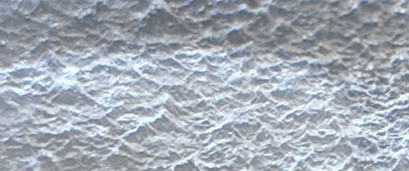
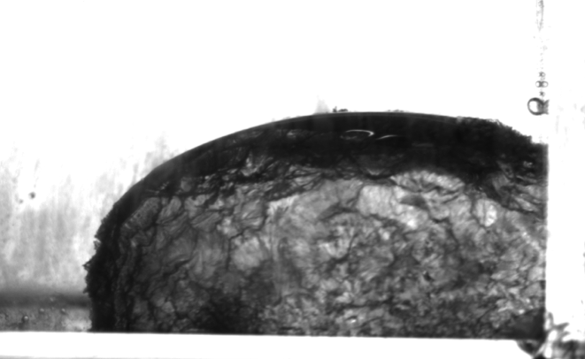
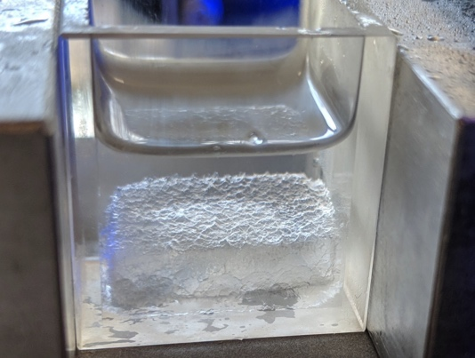
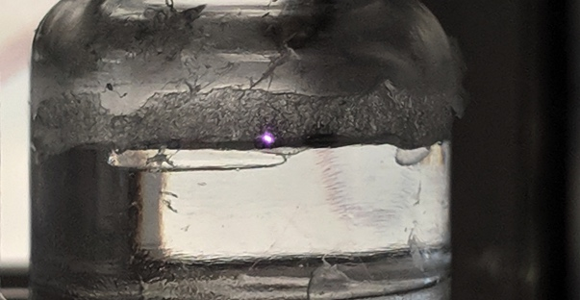
Formation of a flat CP hydrate surface
A challenging process
Goal: Rigid, flat and smooth layer
Hydrate forming compound: Cyclopentane C₅H₁₀
Forms at atmospheric pressure, stable for T < 7°C
Only grows at the interface when no surfactant
Nucleation can be initiated by: seeding (by ice or hydrate), stirring, temperature variations
CP
DI Water
Hydrate at CP/ Water interface:
Uniform coverage but neither smooth nor flat - pinning
Once CP has evaporated
Non-rigid layer, mushy texture
Hydrate layer
CP
Hydrate crystals floating
(Inside) DI Water
DI Water

Slide 6
Formation of a flat CP hydrate surface
Final procedure
A very thin layer of ice is formed in liquid CP at -20°C. Hydrate nucleation is initiated by slowly raising the temperature above ice melting point.
Hydrate formation
on the other side
Hydrate layer growing
2
Rest overnight for the layer to develop
4
3
Flip the
hydrate+ice sample
1
Ice melting initiating hydrate formation at the interface
Freeze
+ Flip
T° cycles
+ overnight rest
CP
CP
CP
Pack + Flip
CP
Ice + CP
DI water + H + CP
Ice + H + CP
H (unpacked)
H smooth and rigid

Slide 7
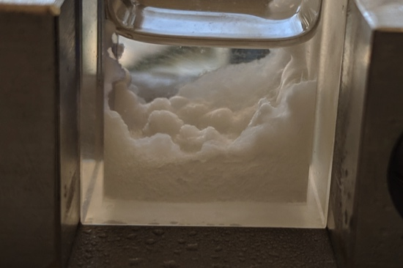
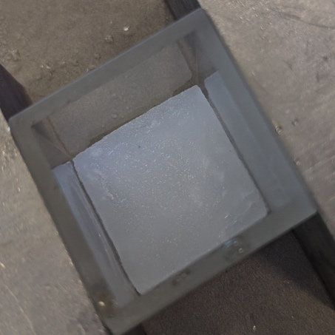
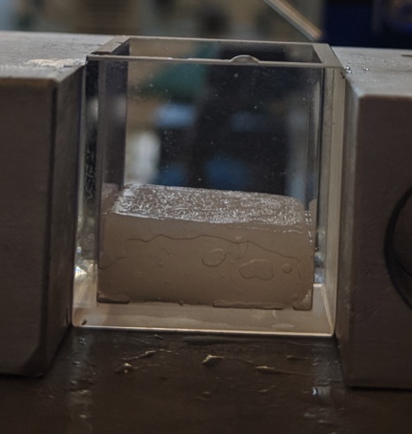
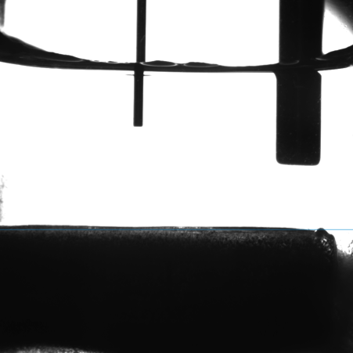
Formation of a flat CP hydrate surface
Results
The hydrate layer often needs to be packed before the last flipping step.
Side used for droplet deposition
With this method, we consistently obtain a flat, smooth and rigid hydrate surface (no ice).
T=2°C
Brine
Tests conducted on the surface
The sample is left at rest in the cabinet above 0°C for several hours to check for stability and residual ice.
Contact angle measurements are also conducted on ice for comparison purposes.

Slide 8
2 – Surface properties of cyclopentane hydrates

Slide 9
Surface properties of cyclopentane hydrates
Choice of the liquid/liquid systems
Criteria
One aqueous phase
(DI Water or Brine)
Ideally oil-field liquids
Non miscible
Should not degrade the hydrate surface (OH groups prohibited)
Contact angle measurement depends on the density ratio of the two liquids
Previous work
Asserson et. al. (2009), Norway ¹
Freon hydrates
Chlorinated hydrocarbons / Water systems
Finite contact angle, water wet
Brown et. al (2018), Colorado School of Mines ²
Cyclopentane hydrates
Cyclopentane / Water system
Finite contact angle of θ=94.2° +/- 8.5°
=> Skeptical about this non intuitive result
hydrate
hydrate
¹ Asserson, R. B., Hoffmann, A. C., Høiland, S., & Asvik, K. M. (2009). Interfacial tension measurement of freon hydrates by droplet deposition and contact angle measurements. Journal of Petroleum Science and Engineering, 68(3-4), 209-217.
² Brown, E. P., Hu, S., Wells, J., Wang, X., & Koh, C. A.. "Direct measurements of contact angles on cyclopentane hydrates." Energy & fuels 32.6 (2018): 6619-6626.

Slide 10
Surface properties of cyclopentane hydrates
Choice of the liquid/liquid systems
Selected systems
Previous work
Asserson et. al. (2009), Norway ¹
Freon hydrates
Chlorinated hydrocarbons / Water systems
Finite contact angle, water wet
Brown et. al (2018), Colorado School of Mines ²
Cyclopentane hydrates
Cyclopentane / Water system
Finite contact angle of θ=94.2° +/- 8.5°
=> Skeptical about this non intuitive result
 | Surrounding Fluid | Droplet phase
1 | Brine | Dichloromethane
2 | Brine | 1,2-Dichloroethane
3 | Brine | Chloroform
4 | Cyclopentane | DI-Water
5 | Olive Oil | Brine
6 | Pumping Oil | Brine
7 | Silicone Oil | Brine
8 | Air | All of the above
¹ Asserson, R. B., Hoffmann, A. C., Høiland, S., & Asvik, K. M. (2009). Interfacial tension measurement of freon hydrates by droplet deposition and contact angle measurements. Journal of Petroleum Science and Engineering, 68(3-4), 209-217.
² Brown, E. P., Hu, S., Wells, J., Wang, X., & Koh, C. A.. "Direct measurements of contact angles on cyclopentane hydrates." Energy & fuels 32.6 (2018): 6619-6626.

Slide 11
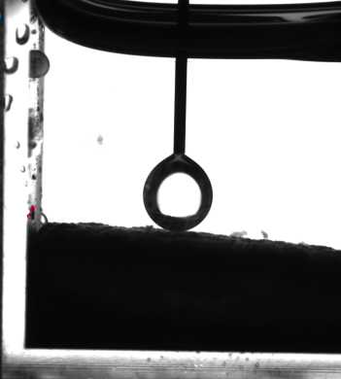
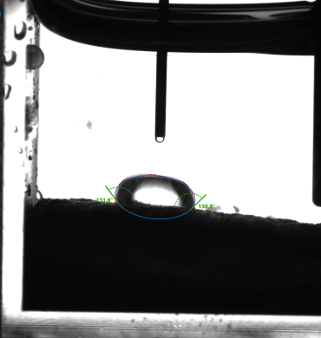
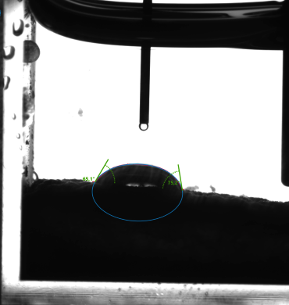
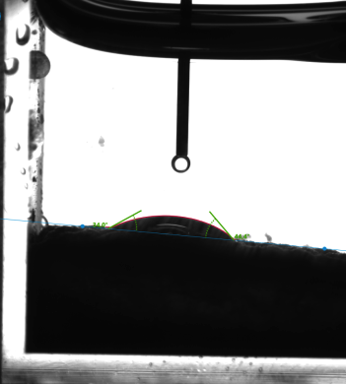
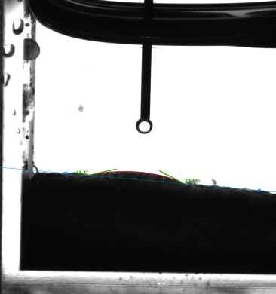
Surface properties of cyclopentane hydrates
Cyclopentane / Water system
A droplet of DI water (V=20µL) is deposited on the hydrate surface, immersed in CP. It spreads out almost completely before turning into hydrate. Temperature is about 1.5C° in the bath.
CP
CP
CP
CP
CP
In contrast with previous work, we find that the hydrate surface is totally wetted by water when immersed in cyclopentane.
Brown et. al ¹ Θ = 94.2° +/- 8.5°
Our work: total wetting Θ close to 0°
t=7s
Water puddle turns into hydrate
t=1s
¹ Brown, E. P., Hu, S., Wells, J., Wang, X., & Koh, C. A.. "Direct measurements of contact angles on cyclopentane hydrates." Energy & fuels 32.6 (2018): 6619-6626.

Slide 12
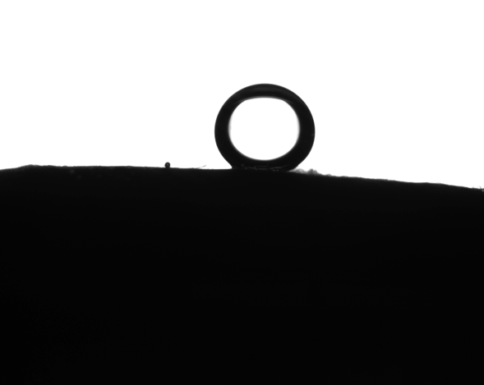
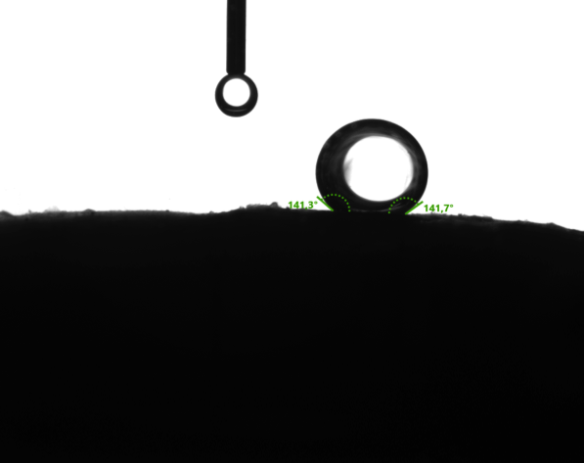
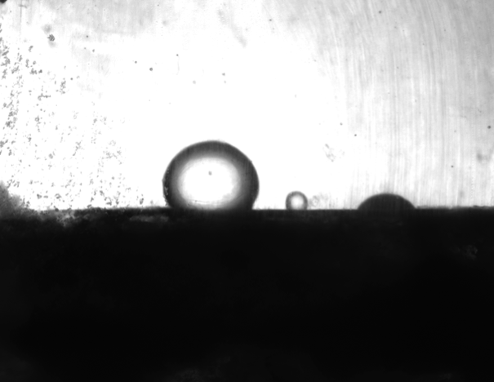
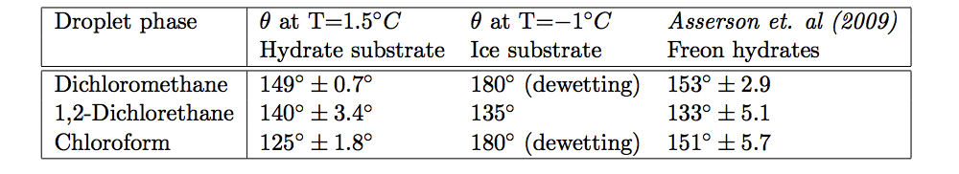
Surface properties of cyclopentane hydrates
Chlorinated Hydrocarbons
Finite contact angles were obtained with brine as the surrounding phase and chlorinated hydrocarbons as the droplet phase.
Contact angle measurements were averaged over:
Multiple droplets for each substrate (tilting of the surface)
Right and left contact angle for each droplet (pinning and hysteresis)
Different hydrate surfaces, over time
Dichloromethane
1,2 - Dichloroethane
Chloroform

Slide 13
Surface properties of cyclopentane hydrates
Chlorinated Hydrocarbons
We obtained the interfacial tension between the droplet phase and the surrounding phase using the pendant drop method.
Young’s law
Young-Dupré equation
where is the work of adhesion
Liquid 1
Liquid 2
Droplet phase | Contact Angle | Interfacial Tension (mN /m) | From Young’s law (mN /m) | Work of adhesion (mN /m)
Dichloromethane | 149° | 27.9 +/- 0.1 | - 23.9 | 4.0
1,2-Dichloroethane | 140° | 26.5 +/- 0.2 | - 20.3 | 6.2
Chloroform | 125° | 27.7 +/- 0.1 | -15.9 | 11.2

Slide 14
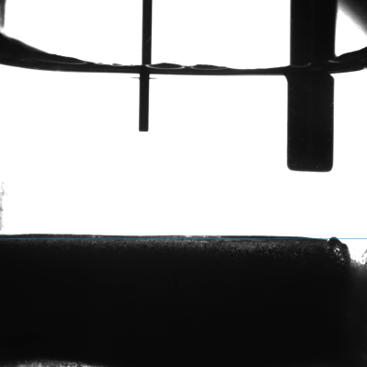
Conclusions
Systematic and robust procedure to create cyclopentane hydrates with a smooth and rigid surface
New information on the wetting properties of cyclopentane hydrates
T=2°C
Brine
Hydrate
Surrounding phase | Droplet phase
Brine | Dichloromethane | 149°
Brine | 1,2-Dichloroethane | 140°
Brine | Chloroform | 125°
Cyclopentane | DI-Water | 0°
Oils (olive, pumping, silicone) | Brine | 0°
Air | All of the above | 0°
The aqueous phase preferentially wets the surface ( >90°).
Chloroform has the highest affinity for the hydrate surface
The aqueous phase totally wets the surface
Any liquid vs. air totally wets the surface

Slide 15
Thank you for your attention!
Questions?

Slide 17
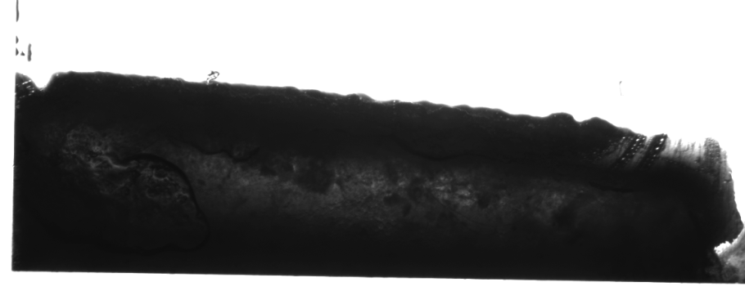
Formation of a flat CP hydrate surface:
Results
No apparent residual water if the ice layer is thin enough to start with.
The hydrate layer often needs to be packed before the last flipping step.
CP
Hydrate surface
Residual water+hydrate
Hydrate layers
Side used for droplet deposition
With this method, we consistently obtain a flat, smooth and rigid hydrate surface (no ice).
T=2°C
Brine
Tests conducted on the surface
The sample is left at rest in the cabinet above 0°C for several hours to check for stability and residual ice.
Contact angle measurements are also conducted on ice for comparison purposes.

Slide 18
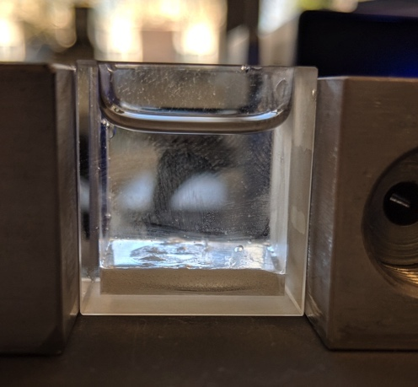
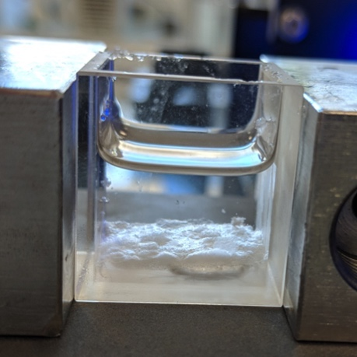
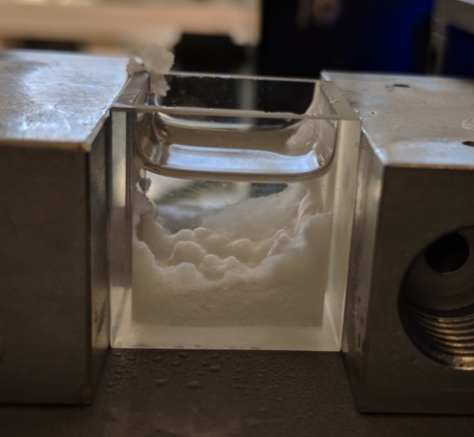
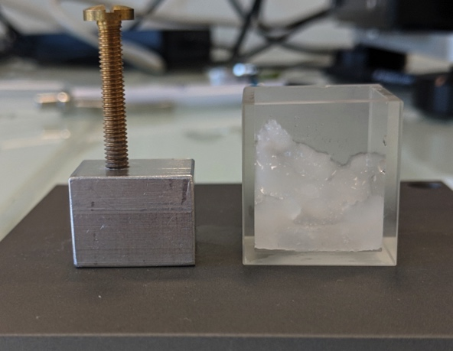
Formation of a flat hydrate surface: some pictures
Slow melting
T > 0°C
Freeze underlying water layer then flip the hydrate+ice sample
Ice immersed in CP
First layer of hydrate
at interface
Overnight rest
Pack + Flip
Hydrate layer on other side grows over T cycles
Next day: sometimes the hydrates grew wild!
Final state

