Slide 1
Diffuse Bounce Back Lattice Boltzmann Method
2019 PIRE Project Annual Review Meeting,
NTNU, Trondheim, Norway
Geng Liu and Taehun Lee
Department of Mechanical Engineering
City College of New York

Slide 2
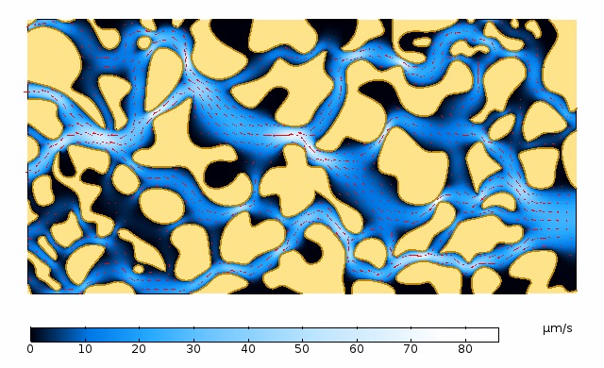
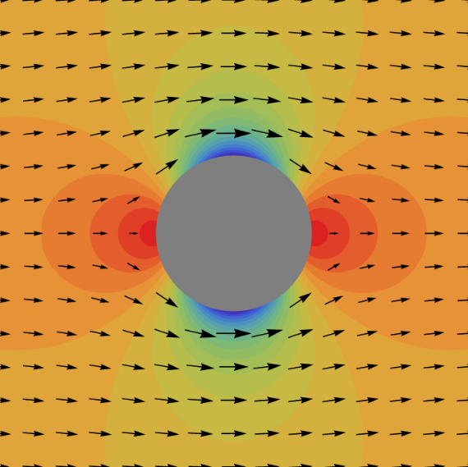
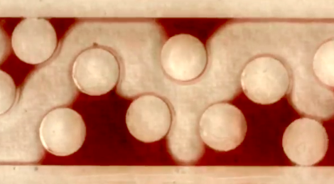
Background
Curve boundary simulations
Stokes circular cylinder flow
Porous media flow
Moving boundary problems
Two phase fluid particle interactions
Fig. 2 Porous media flow[1]
Fig. 1 Pressure field of Stokes cylinder flow
Fig. 3 Two phase fluid particle interactions
[1] Andrew Young, Computing Porosity and Permeability in Porous Media with a Submodel. https://www.comsol.com/blogs/computing-porosity-and-permeability-in-porous-media-with-a-submodel

Slide 3
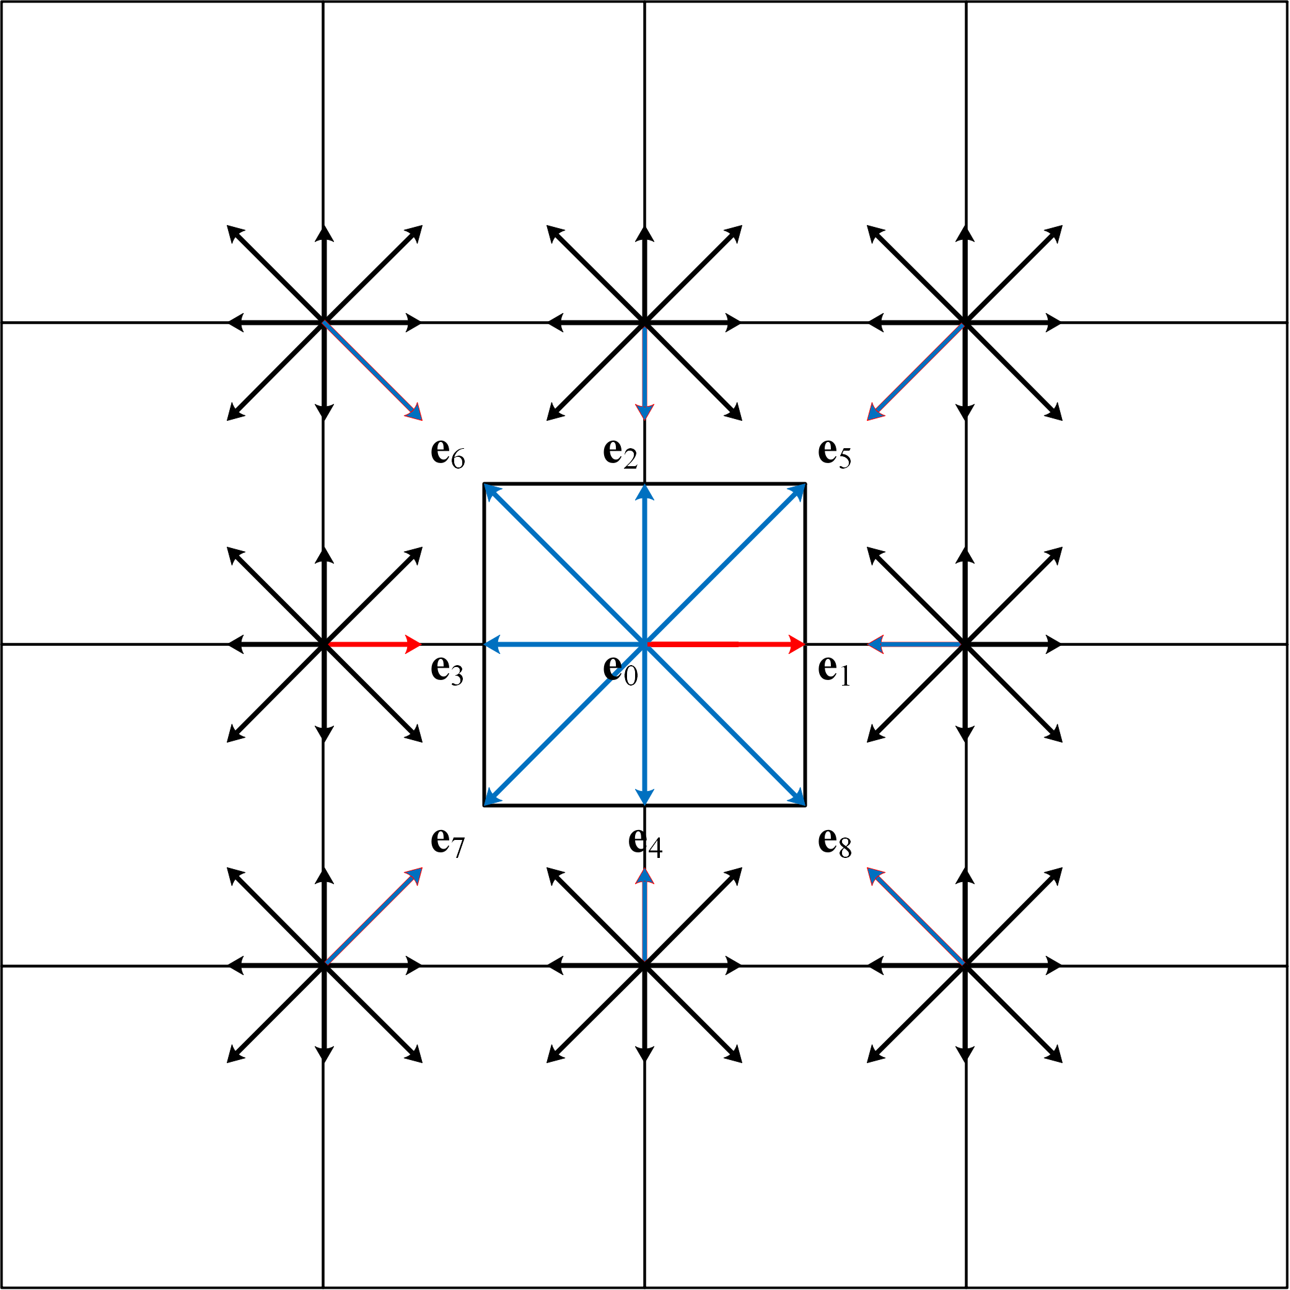
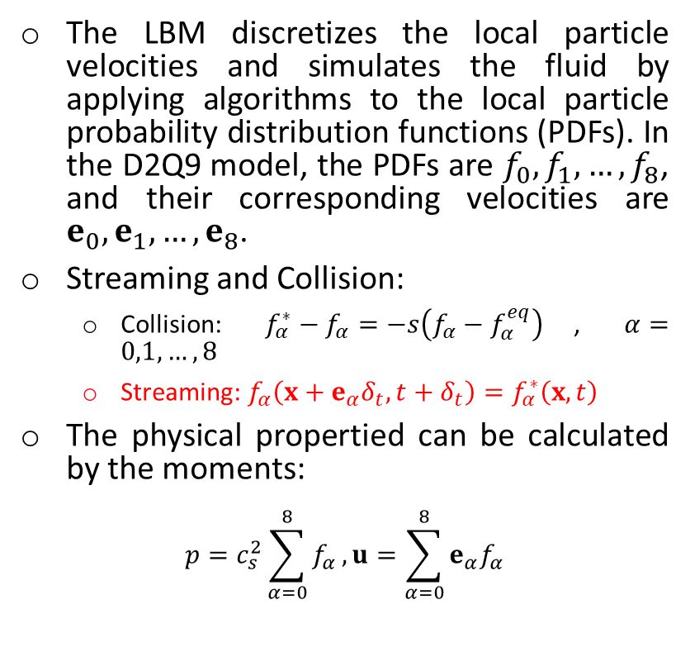
Lattice Boltzmann method
The LBM discretizes the local particle velocities and simulates the fluid by applying algorithms to the local particle probability distribution functions (PDFs). In the D2Q9 model, the PDFs are $f_{0},f_{1}, …,f_{8}$, and their corresponding velocities are $e_{0},e_{1}, …,e_{8}$.
Streaming and Collision:
Collision: $f_{α}^{∗}−f_{α}=−s\left(f_{α}−f_{α}^{eq}\right)$, $α=0,1,…,8$
Streaming: $f_{α}\left(x+e_{α}δ_{t},t+δ_{t}\right)=f_{α}^{∗}\left(x,t\right)$
The physical propertied can be calculated by the moments:
$$p=c_{s}^{2}\sum_{α=0}^{8}{f_{α}},u=\sum_{α=0}^{8}{{e_{α}f}_{α}}$$
Fig. 4 D2Q9 Model

Slide 4
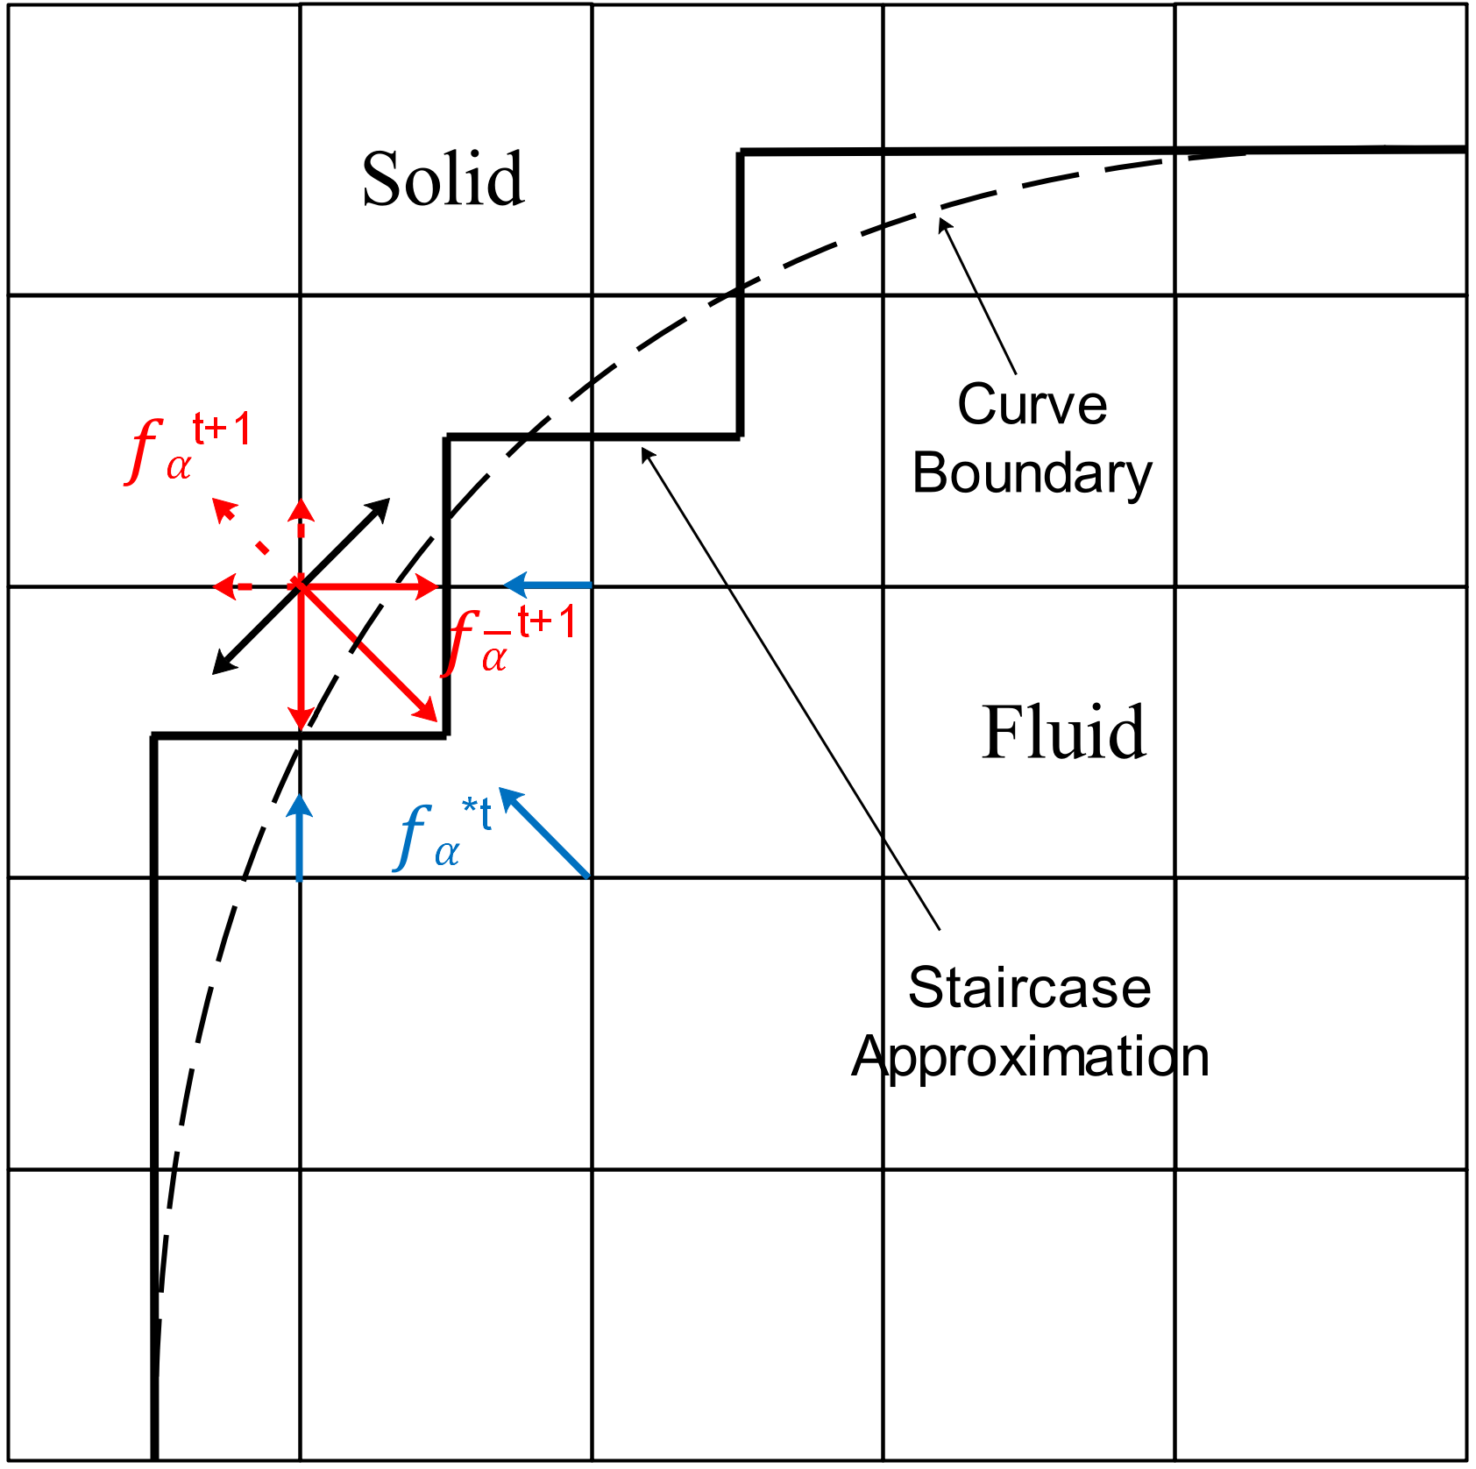
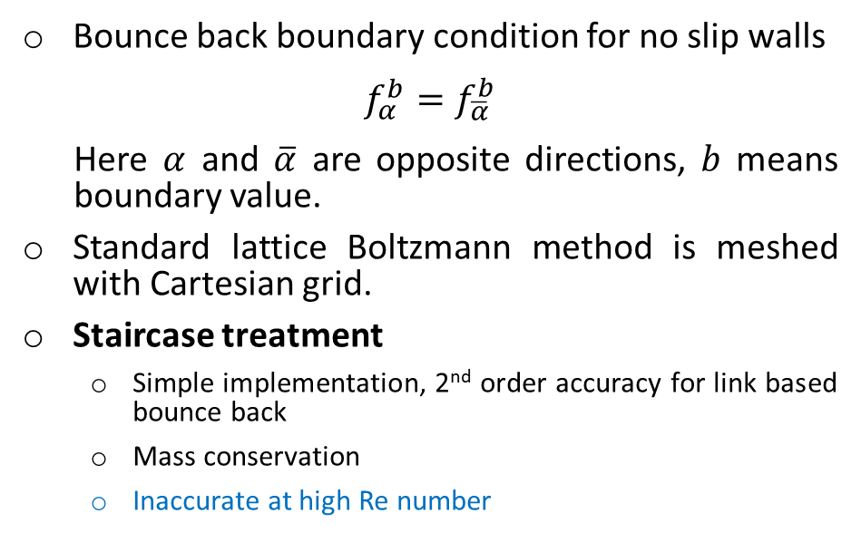
Bounce back boundary condition
Bounce back boundary condition for no slip walls
$$f_{α}^{b}=f_{\overline{α}}^{b}$$
Here $α$ and $\overline{α}$ are opposite directions, $b$ means boundary value.
Standard lattice Boltzmann method is meshed with Cartesian grid.
Staircase treatment
Simple implementation, 2nd order accuracy for link based bounce back
Mass conservation
Inaccurate at high Re number
Fig. 5 Staircase approximation for curve boundary on Cartesian grid
Interpolated Bounce Back (e.g. Bouzidi Method)
Sharp boundary, 2nd order accuracy
Force fluctuation
[1]M. Bouzidi, M. Firdaouss, P. J. Lallemand, Momentum transfer of a Boltzmann-lattice fluid with boundaries, Journal of Computational Physics 13 (11) (2003) 3452–3459.

Slide 5
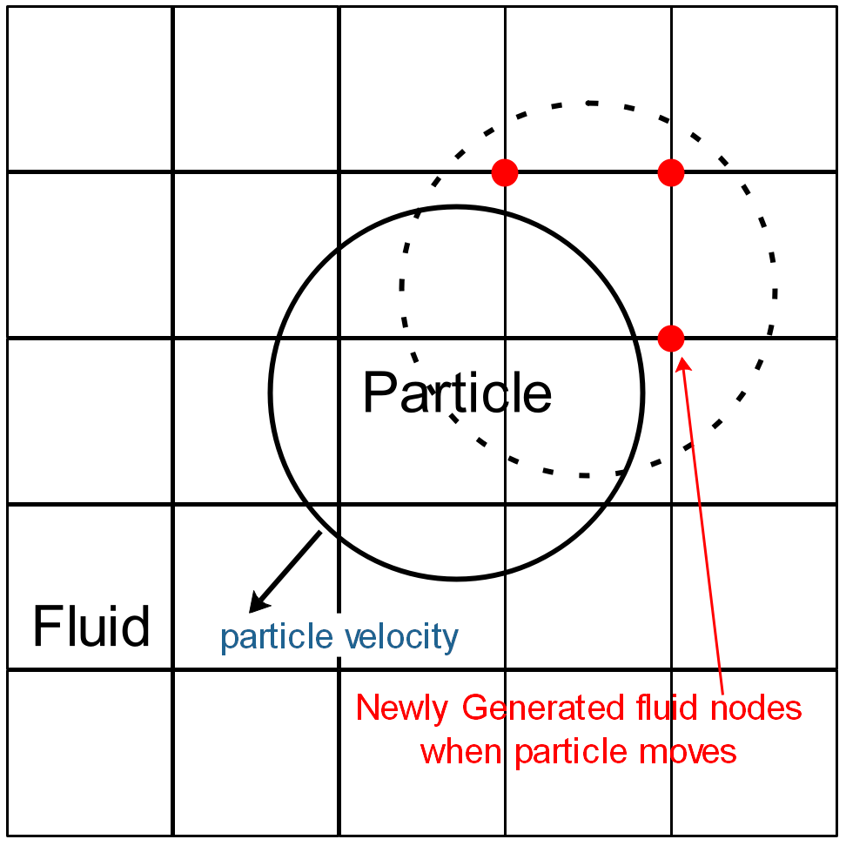
Implicit boundary conditions
 | order of accuracy | boundary force
Sharp Boundary | Usually 2nd order | Fluctuation large
Diffuse Boundary | Mostly 1st order | Fluctuation small
Immersed Boundary Method [1]
Smooth boundary can reduce the force fluctuation
Originally invented to solve membrane problems, it employs a set of Lagrangian points to explicitly describe the geometry
Partially Saturated Method (PSM)
Geometry is described by an order parameter
Noble’s Method [2] modifies collision and post processing
Bounce back is not recovered at sharp boundary limit
Fig. 6 Unknown nodes in moving boundary problem
[1] Yan Peng and Li-Shi Luo , A comparative study of immersed-boundary and interpolated bounce-back methods in LBE. Progress in Computational Fluid Dynamics, Vol. 8, Nos. 1–4, 2008
[2] D.R. Noble, J.R. Torczynski, A Lattice-Boltzmann Method for Partially Saturated Computational Cells. Int. J. Mod. Phys. C 09(08), 1189 (1998)

Slide 6
Basic ideas of diffuse bounce back method
Inspired by diffuse boundary application solved with Navier-Stokes equation governed finite element method [1], it incorporates bounce back condition directly into discrete Boltzmann equation.
In this work the bounce back condition, instead of imposed boundary velocity is substituted into the lattice Boltzmann equation.
Since collision is local, only streaming step is modified.
Converge to bounce back boundary condition at sharp boundary limit.
Fig. 7 Two phase lid driven cavity solved with diffuse boundary method[1]
Fig. 8 Simulation done by Aland et al. with diffuse geometry approach. [1]
[1] S. Aland, J. Lowengrub, A. Voigt, Two-phase flow in complex geometries: A diffuse domain approach, Comput Model Eng Sci. 57 (1) (2010) 77–106.

Slide 7
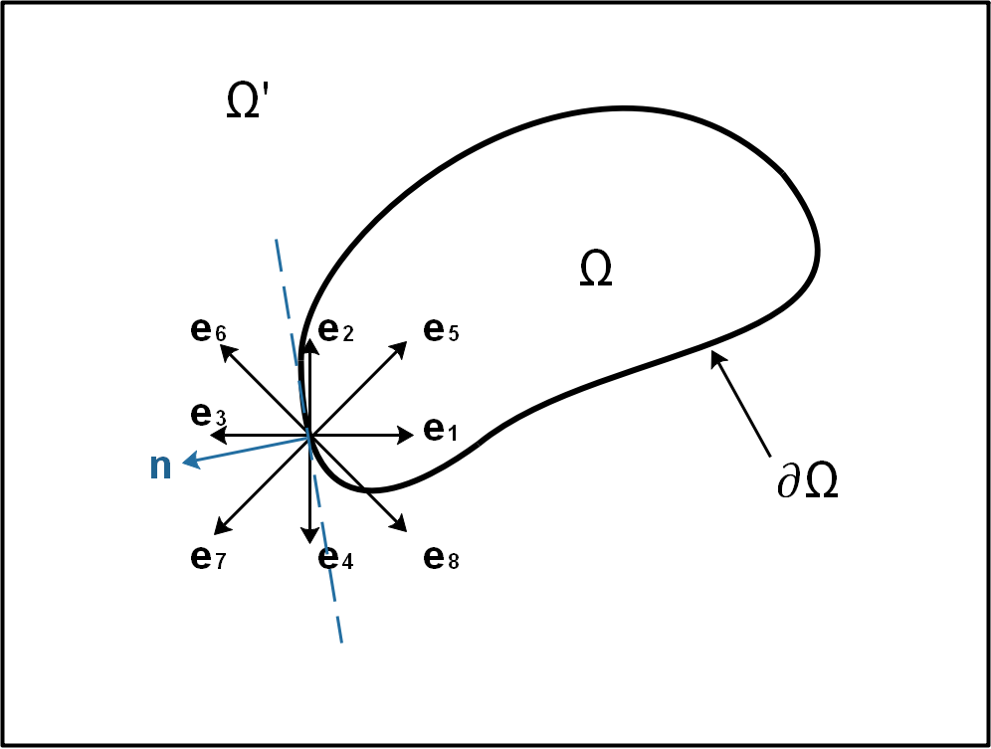
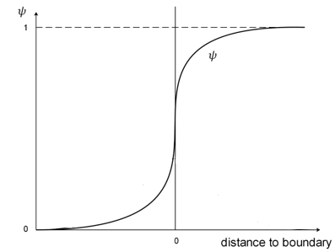
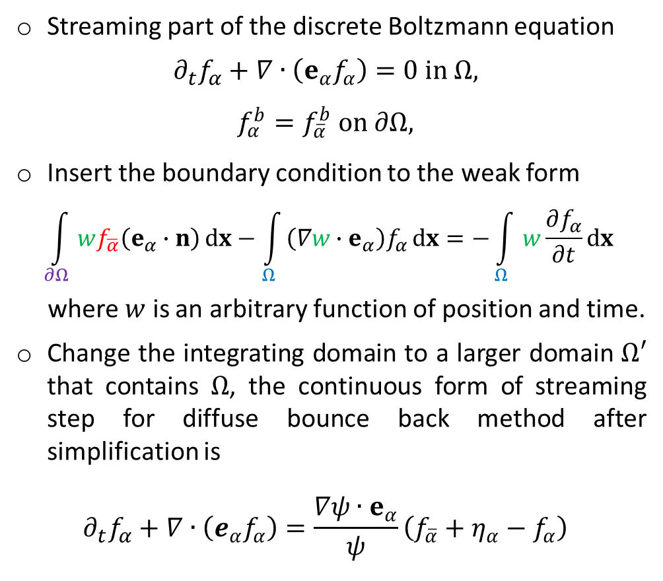
Derivation
Streaming part of the discrete Boltzmann equation
$$∂_{t}f_{α}+∇∙\left(e_{α}f_{α}\right)=0 in Ω,$$
$$f_{α}^{b}=f_{\overline{α}}^{b} on ∂Ω,$$
Insert the boundary condition to the weak form
$$\int_{∂Ω}{wf_{\overline{α}}\left(e_{α}∙n\right)dx}−\int_{Ω}{\left(∇w∙e_{α}\right)f_{α}dx}=−\int_{Ω}{w\frac{∂f_{α}}{∂t}dx}$$
where $w$ is an arbitrary function of position and time.
Change the integrating domain to a larger domain $Ω′$ that contains $Ω$, the continuous form of streaming step for diffuse bounce back method after simplification is
$$∂_{t}f_{α}+∇∙\left(e_{α}f_{α}\right)=\frac{∇ψ∙e_{α}}{ψ}\left({f_{\overline{α}}+η_{α}−f}_{α}\right)$$
Wall
fluid
Solid
Wall
Solid
fluid
Fig. 9 Change integration domain

Slide 8
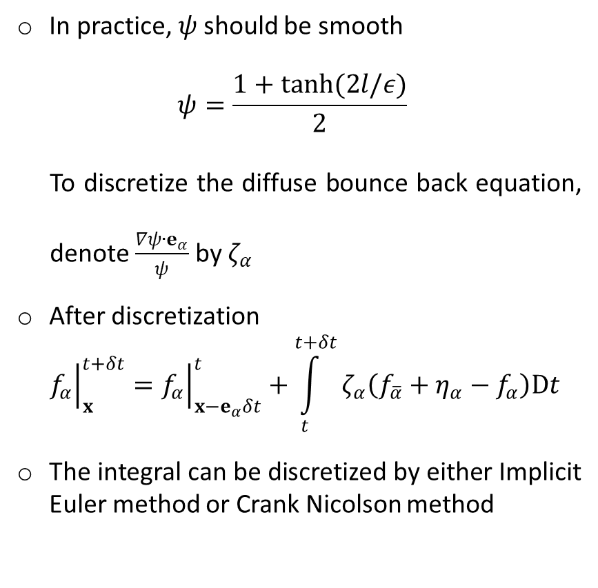
Discretization
In practice, $ψ$ should be smooth
$$ψ=\frac{1+tanh(2l/ε)}{2}$$
To discretize the diffuse bounce back equation, denote $\frac{∇ψ∙e_{α}}{ψ}$ by $ζ_{α}$
After discretization
$${\left.f_{α}\right|}_{x}^{t+δt}={\left.f_{α}\right|}_{x−e_{α}δt}^{t}+\int_{t}^{t+δt}{ζ_{α}\left({f_{\overline{α}}+η_{α}−f}_{α}\right)Dt}$$
The integral can be discretized by either Implicit Euler method or Crank Nicolson method
Wall
fluid
Solid
Wall
Solid
fluid
Fig. 9 Change integration domain

Slide 9
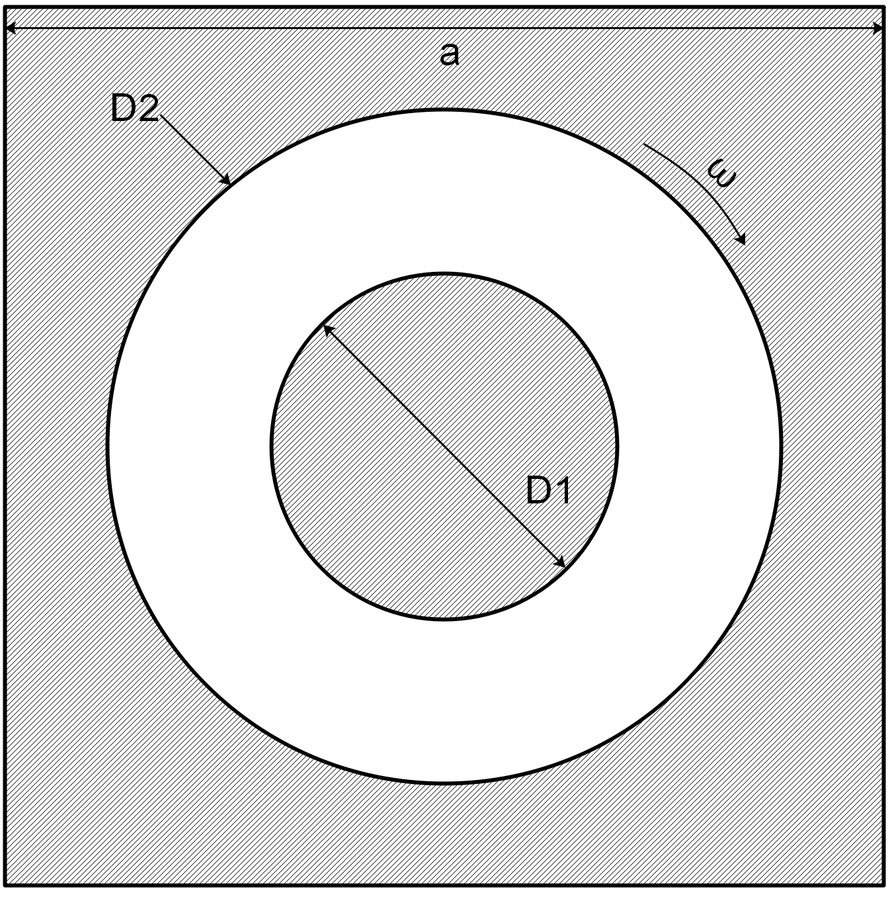
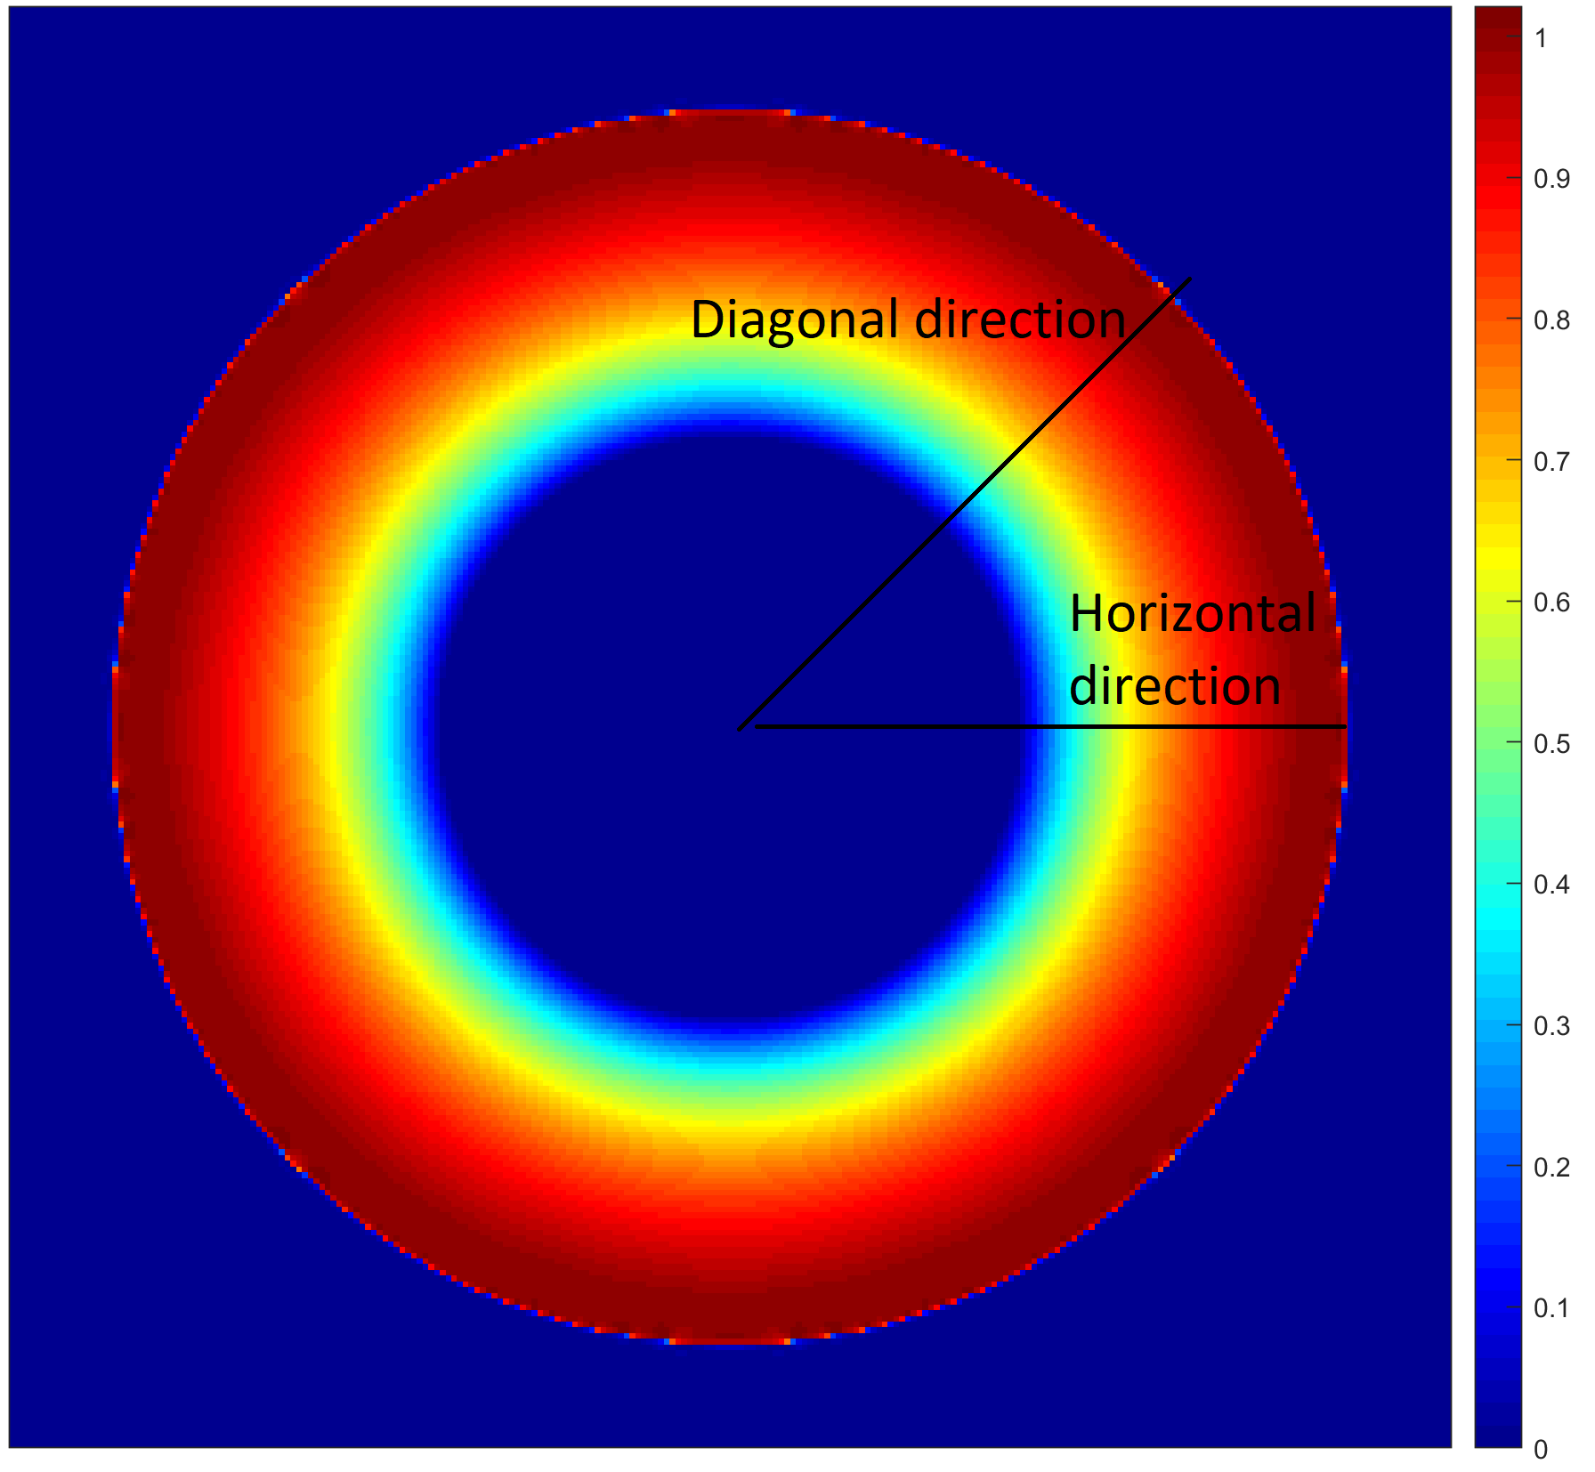
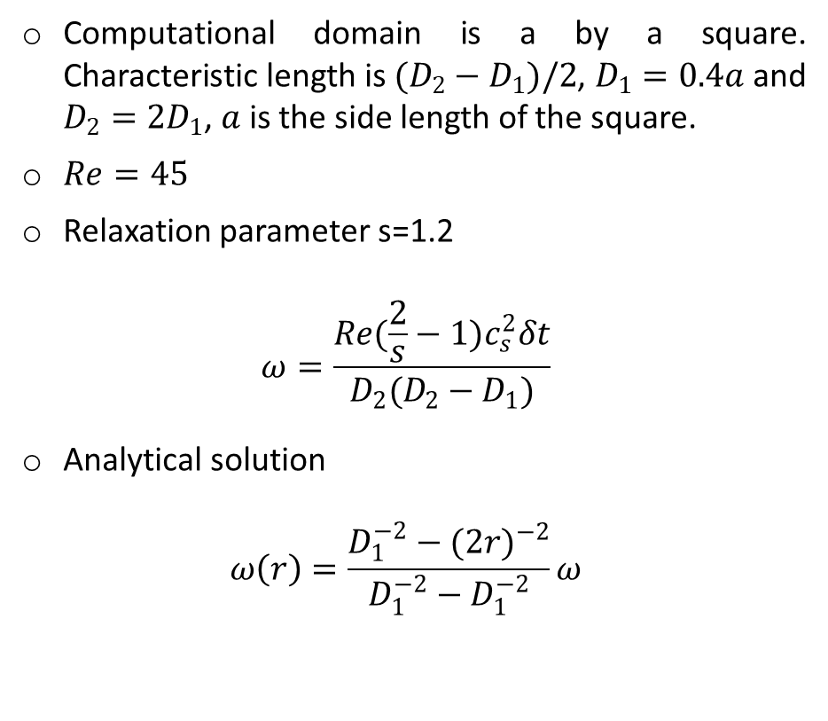
Taylor Couette flow
Computational domain is a by a square. Characteristic length is $(D_{2}−D_{1})/2$, $D_{1}=0.4a$ and $D_{2}=2D_{1}$, $a$ is the side length of the square.
$Re=45$
Relaxation parameter s=1.2
$$ω=\frac{Re(\frac{2}{s}−1)c_{s}^{2}δt}{D_{2}(D_{2}−D_{1})}$$
Analytical solution
$$ω\left(r\right)=\frac{D_{1}^{−2}−{(2r)}^{−2}}{D_{1}^{−2}−D_{1}^{−2}}ω$$
Fig. 10 Setup of Taylor Couette flow
Fig. 11 Angular velocity field for steady state Taylor Couette flow

Slide 10
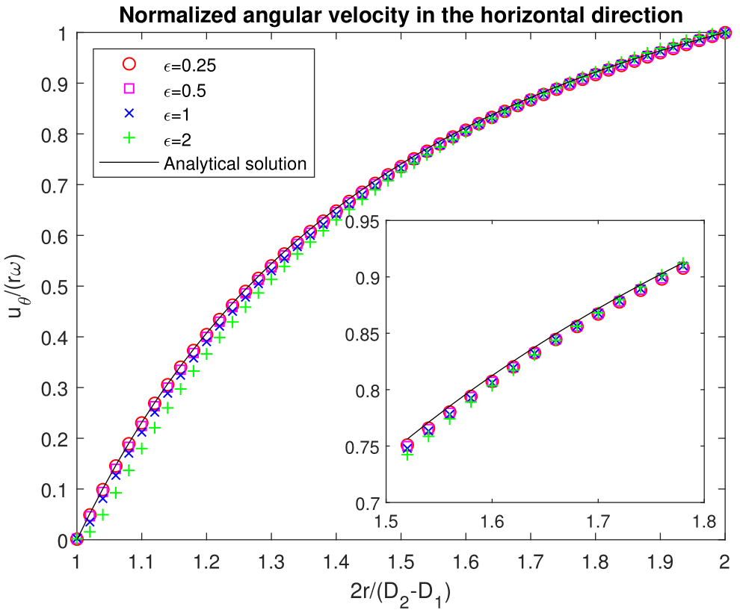
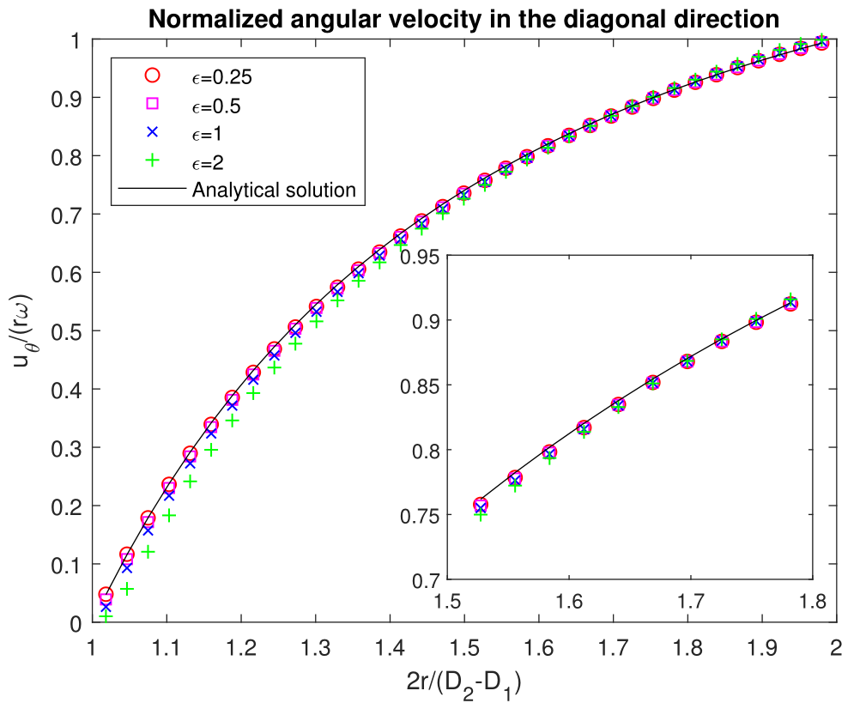
Dependence on boundary thickness
Implicit Euler Method, boundary thickness=0.25,0.5,1,2
The result of Crank Nicolson Method is similar
Fig. 12 Taylor Couette Flow: Dependence on boundary thickness

Slide 11
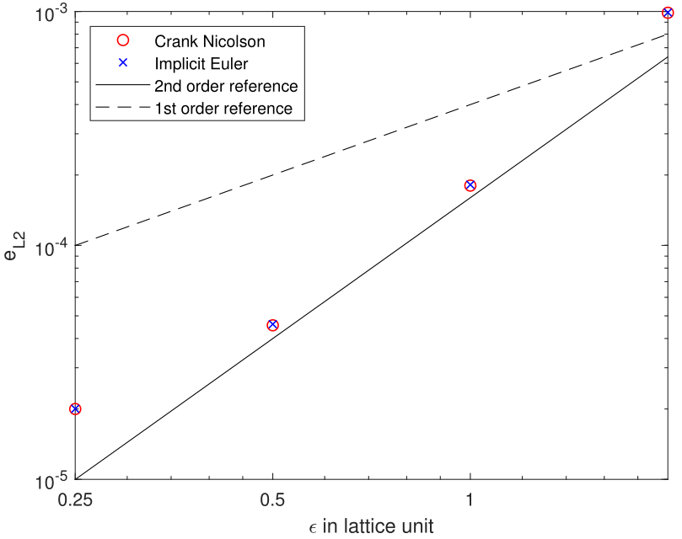
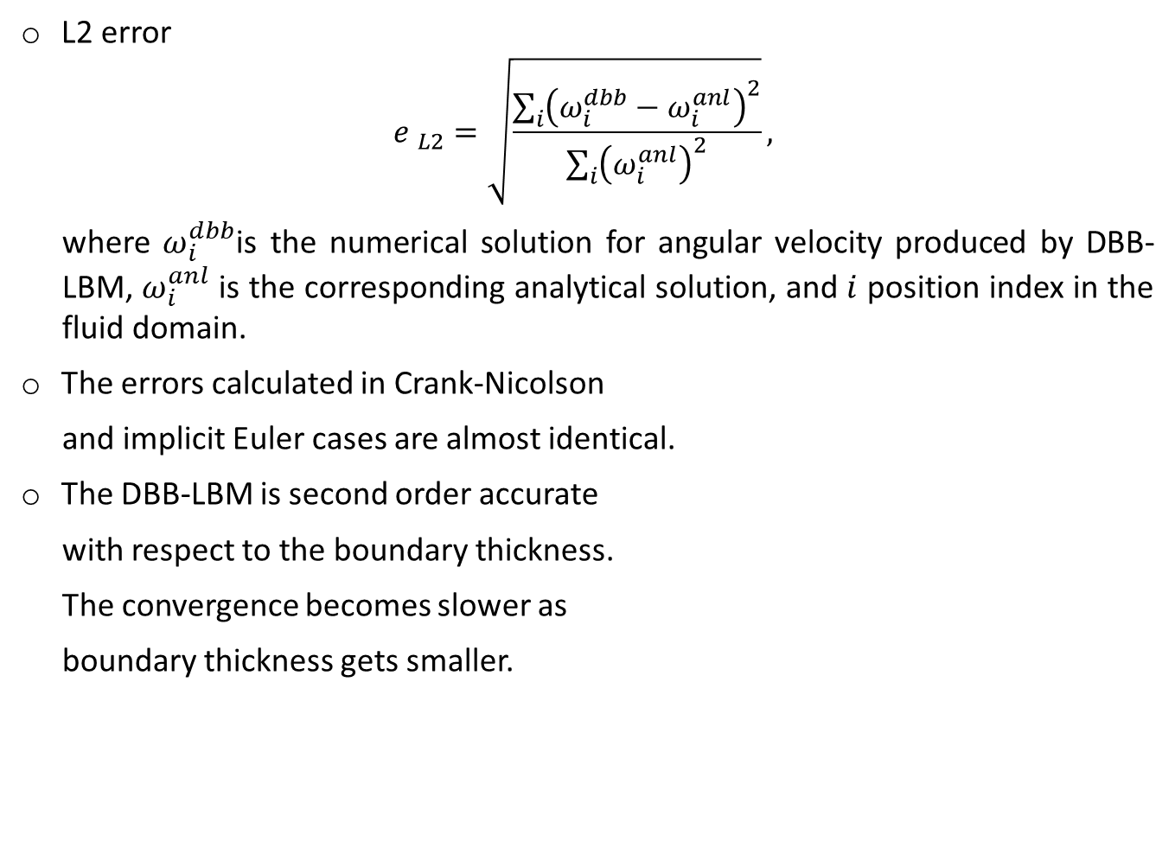
Dependence on boundary thickness
L2 error
$${e }_{L2}=\sqrt{\frac{\sum_{i}{{\left(ω_{i}^{dbb}−ω_{i}^{anl}\right)}^{2}}}{\sum_{i}{{\left(ω_{i}^{anl}\right)}^{2}}}},$$
where $ω_{i}^{dbb}$is the numerical solution for angular velocity produced by DBB-LBM, $ω_{i}^{anl}$ is the corresponding analytical solution, and $i$ position index in the fluid domain.
The errors calculated in Crank-Nicolson
and implicit Euler cases are almost identical.
The DBB-LBM is second order accurate
with respect to the boundary thickness.
The convergence becomes slower as
boundary thickness gets smaller.
Fig. 13 Convergence of diffuse boundary v.s. boundary thickness

Slide 12
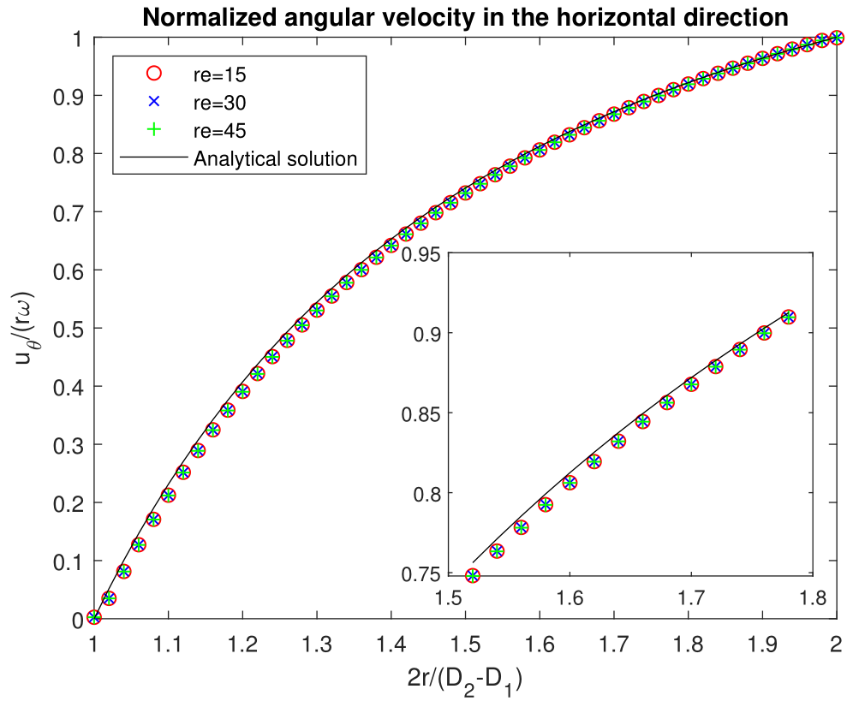
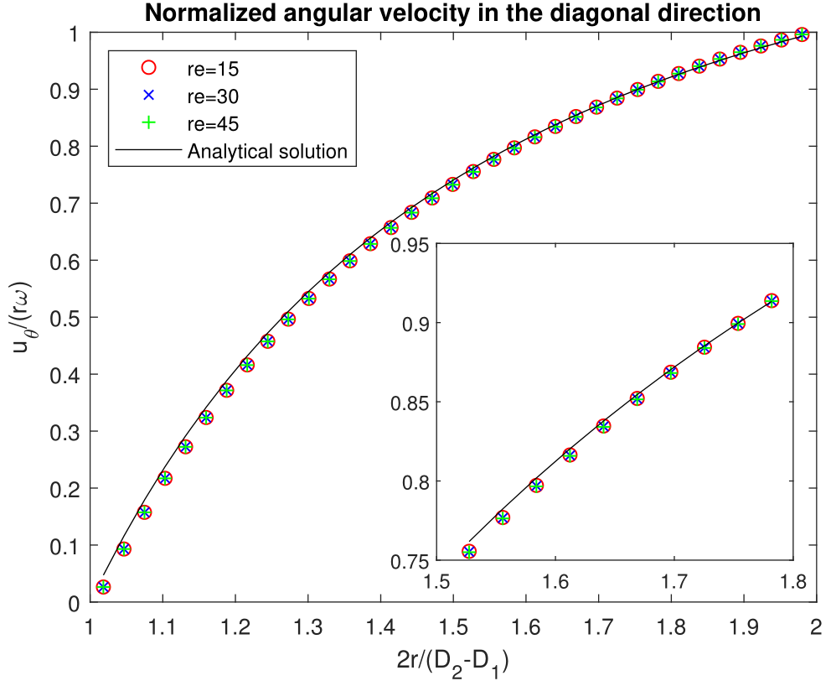
Dependence on the Reynolds number
Implicit Euler Method, $Re=15,30,45$
Fig. 14 Dependence on Reynolds number

Slide 13
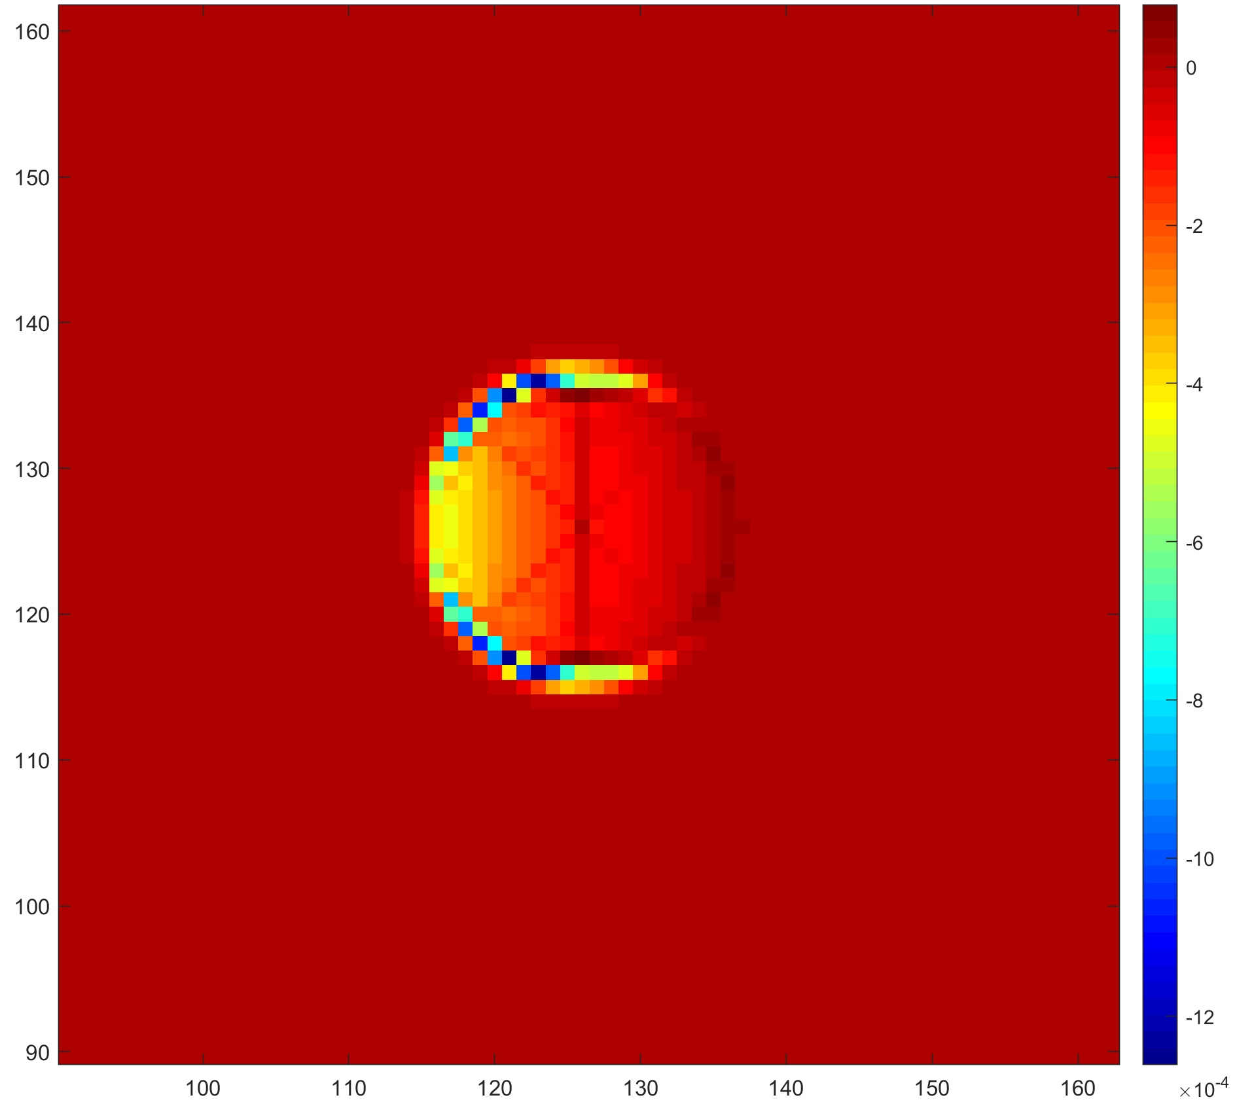
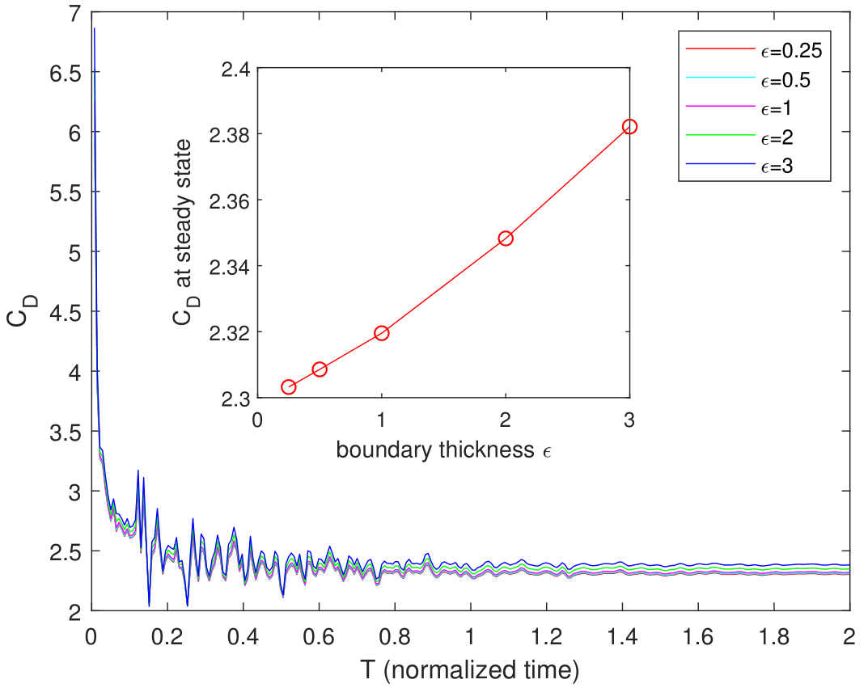
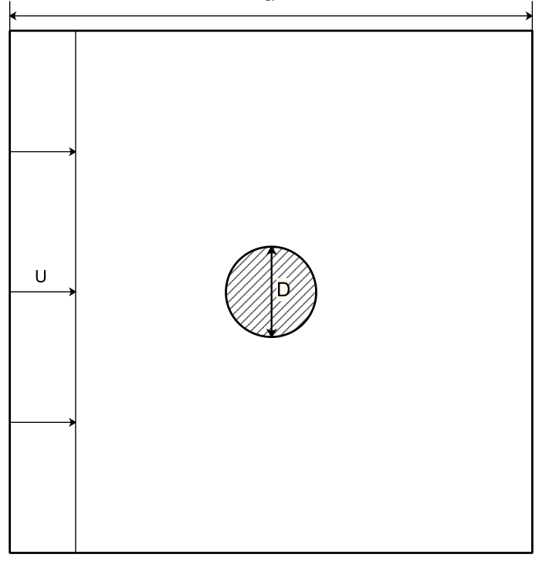
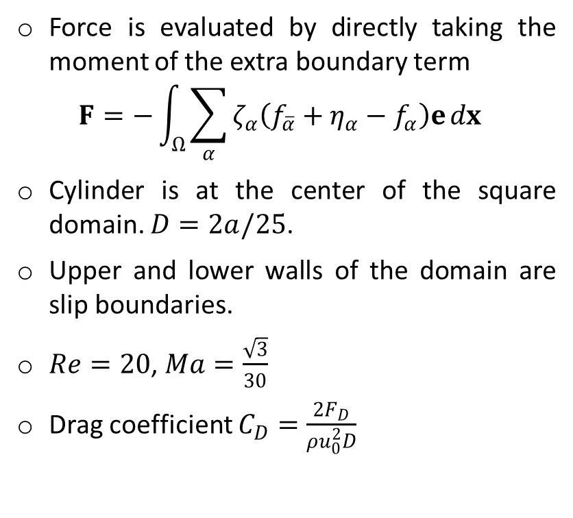

2D cylinder flow
Force is evaluated by directly taking the moment of the extra boundary term
$$F=−\int_{Ω}{\sum_{α}{ζ_{α}\left({f_{\overline{α}}+η_{α}−f}_{α}\right)e}dx}$$
Cylinder is at the center of the square domain. $D=2a/25$.
Upper and lower walls of the domain are slip boundaries.
$Re=20$, $Ma=\frac{\sqrt{3}}{30}$
Drag coefficient $C_{D}=\frac{2F_{D}}{ρu_{0}^{2}D}$
Fig. 16 Force density field
Fig. 17 History of $C_{D}$ under different boundary thickness
Fig. 15 Setup of Cylinder flow

Slide 14
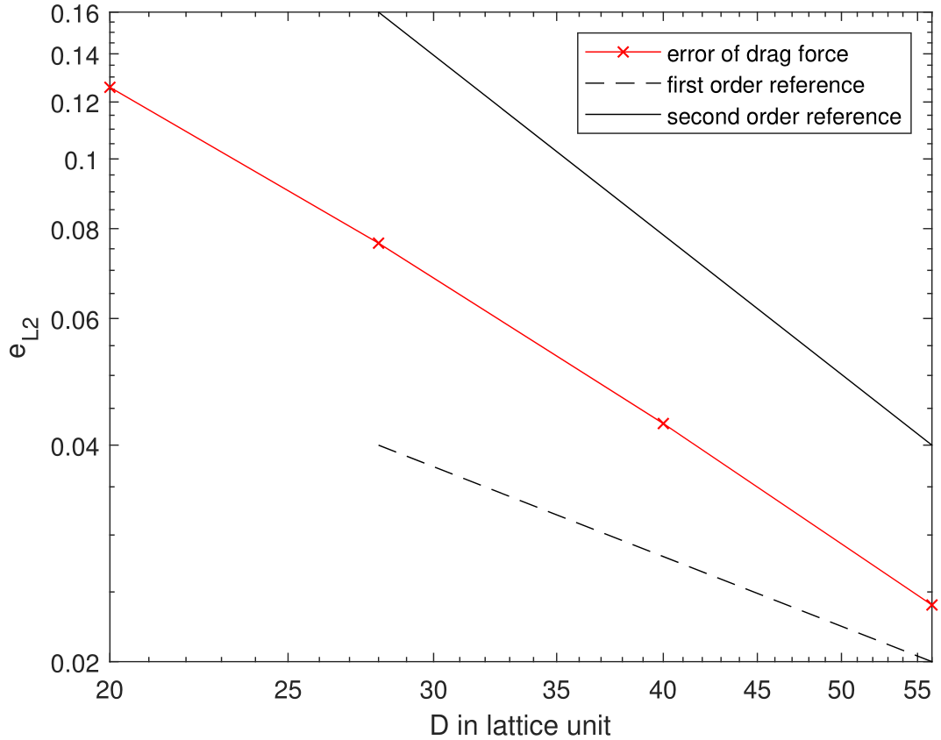
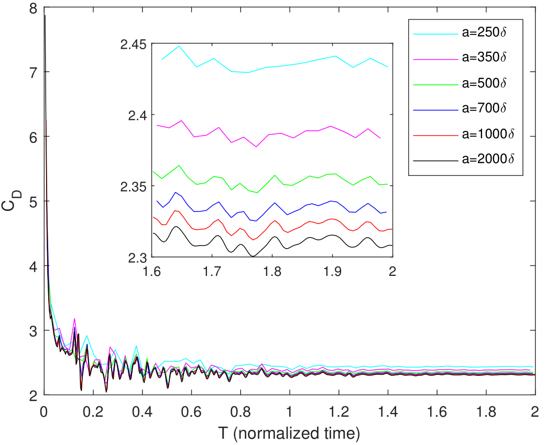
Force convergence test
Boundary thickness 1.
Worse improvement can be found when refining a coarse mesh.
2nd order accuracy due to symmetric geometry.
Fig. 18 Convergence v.s. resolution
Fig. 19 Force history at different resolutions

Slide 15
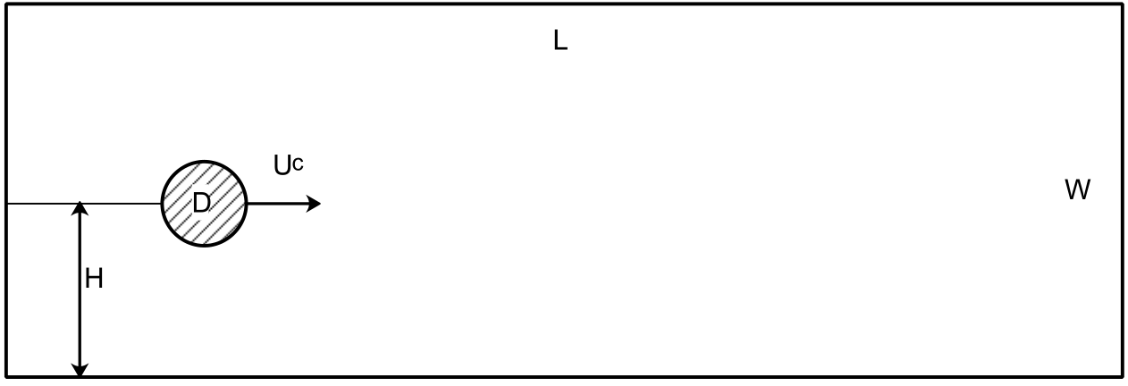
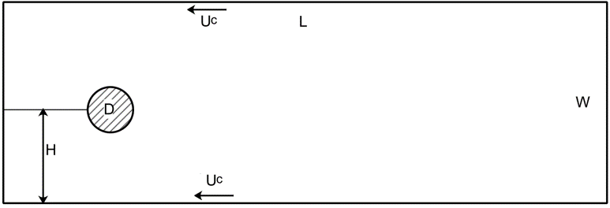
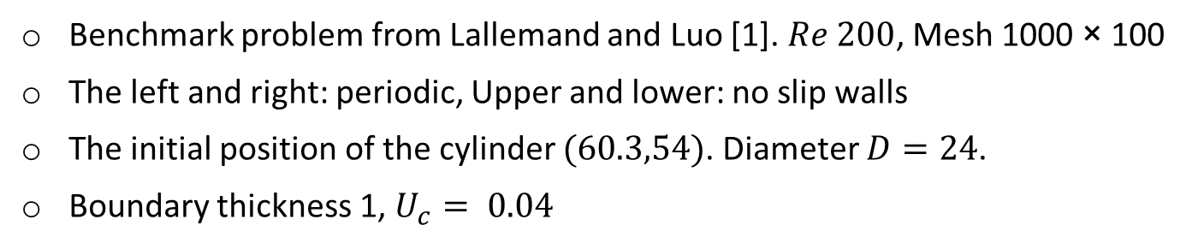
Moving cylinder
Benchmark problem from Lallemand and Luo [1]. $Re 200$, Mesh 1000 × 100
The left and right: periodic, Upper and lower: no slip walls
The initial position of the cylinder $(60.3,54)$. Diameter $D=24$.
Boundary thickness 1, $U_{c}= 0.04$
Fig. 20 Setup of moving wall/particle flow
[1] P. Lallemand, L.-S. Luo, Lattice Boltzmann method for moving boundaries, Journal of Computational Physics 184 (2003) 406–421.

Slide 16
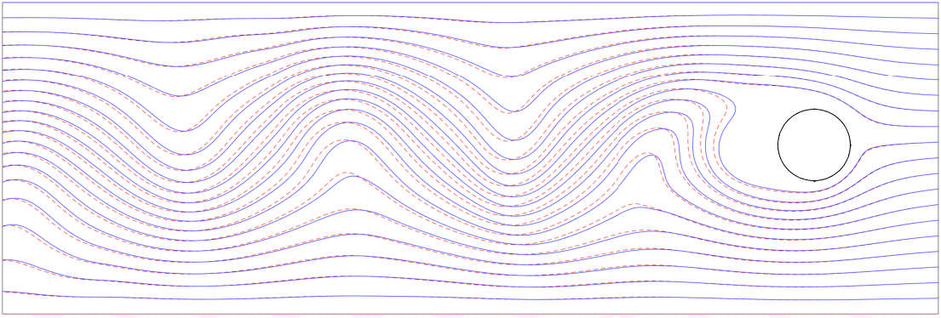
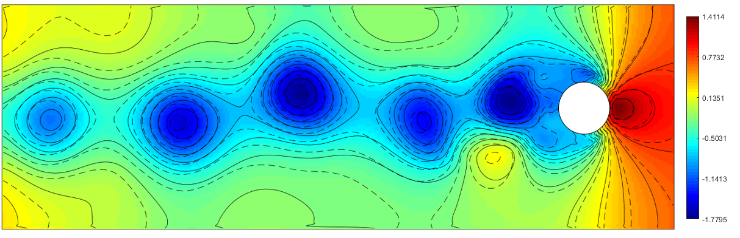
Solution at t=0.125
Fig. 21 Streamlines at t=0.125, Solid lines-moving wall case, dash lines -moving cylinder case.
Fig. 22 Pressure field at t=0.125, Solid lines-moving wall case, dash lines -moving cylinder case.

Slide 17
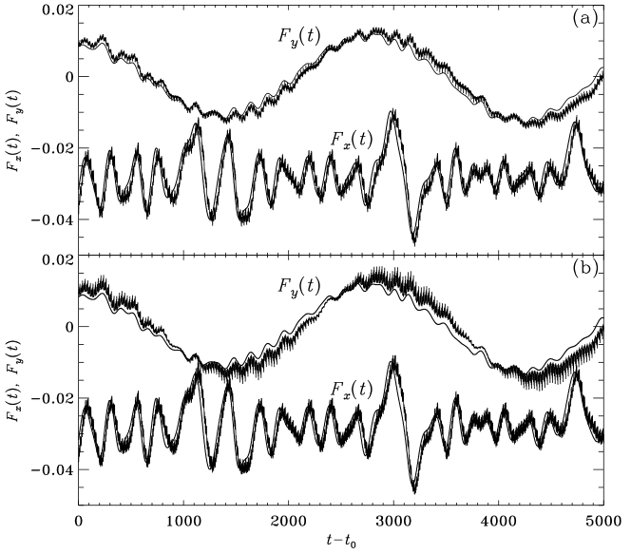
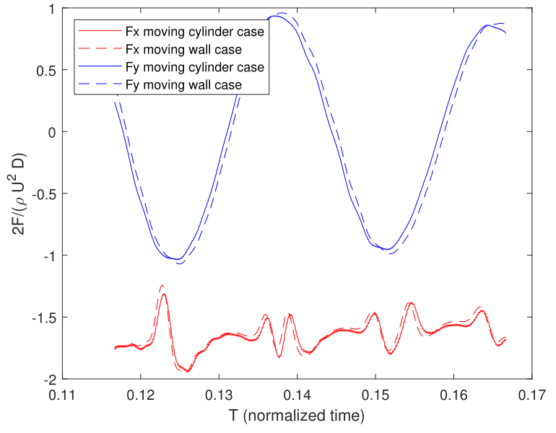
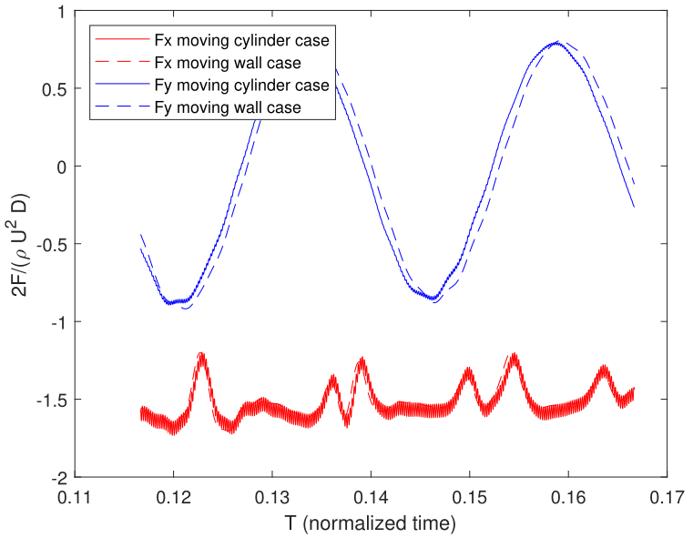
Fluctuation dependence on boundary thickness
As boundary thickness increases from 0.5 to 1, although the solution becomes less accurate, the fluctuations become smaller
(a)
(b)
Fig. 23 Force history Lallemand and Luo’s results.
2nd order extrapolation
Equilibrium distribution
Fig. 24 Diffuse bounce back results. (a) Boundary thickness=1
(b) Boundary thickness=0.5

Slide 18
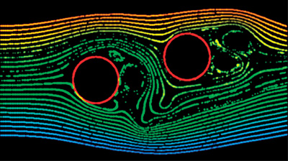
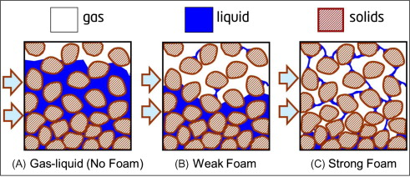
Future work
Two particle interaction problem and falling particle problems
Dynamics of solids can be coupled with the fluid field
Two phase flow problems
Apply diffuse boundary method to both Momentum governing equation and phase governing equation.
Gas-liquid/foam through porous media
Fig. 25 Particle advection in a 2D Flow Field [1]
Fig. 26 Gas-liquid/foam through porous media [2]
[1] https://developer.nvidia.com/gpugems/GPUGems2/gpugems2_chapter47.html
[2] S. Lee, S.I. Kam, Enhanced Oil Recovery by Using CO2 Foams. Enhanced Oil Recovery Field Case Studies, 2013

Slide 19
Acknowledgements
This project is supported by Partnerships for International Research and Education (PIRE), National Science Foundation (NSF). We want to thank Fanny Thomas, Prof. Masahiro Kawaji and Prof. Jeff Morris for the discussions on applications. And thanks to Dr. Harald Linga and the Norwegian collaborators for hosting the PIRE Annual Review Meeting.

Slide 20
THANK YOU

