Slide 1
Drilling fluids – Recent and future research topics addressed at SINTEF
PIRE Project Annual Review Meeting June 18-20,
The City College of New York, CUNY
Presentation for Thrust III Drilling fluids.
Harald Linga, SINTEF
Notes:
Bildet illustrerer:
· bredden i SINTEFs ekspertise, fra havrom til verdensrom.
· hvilke områder og bransjer vi jobber innen for å realisere visjonen Teknologi for et bedre samfunn.
Bildestilen er basert på stikkordene fremtidsrettet, teknologi og norsk natur (naturressurser). SINTEFs visuelle univers er utviklet for SINTEF av Headspin Productions AS.

Slide 2
Slide 2
Content
Motivation & technology needs for drilling&well operations
Key features for drilling as a multiphase flow operation
Drilling & Well - SINTEFs profile and role
Selected projects, deliverables and results
Future topics

Slide 3
Slide 3
Motivation & technology needs for D&W operations
Field development cost offshore – 40% related to drilling and well
Drilling performance decisive for investments/reservoir development
Proportion of mature, marginal fields are growing
More challenging drilling operations
Extended Reach Drilling (ERD) - longer /deeper (8 km ++ )
High Pressure High Temperature (HPHT) (800 bar ++, 150 C ++)
Depleted reservoirs (pressure anomalies, loss of fluid)
Exploration in arctic regions (topside temperature, HSE, logistics)

Slide 4
Key features drilling; parameters and flow phenomena
Q_{IN}
Drilling fluid COMPOSITION
Q_{OUT}
Drilling fluid characteristics and properties
essential for safe and efficient drilling performance
MULTIPLE FLUIDS
HYDRATE
DENSITY(p,T,i)
MULTI PHASE FLOW
RHEOLOGY(p,T,i)
PHASE/PVT PROPERTIES drilling fluid/GAS/OIL/CONDENSATE
THERMOPHYSICAL PROPERTIES
CUTTINGS TRANSPORT
Q_{LOSS}
DYNAMIC INFLUX Q_{RESERVOIR}
Colour legend:
RED: Real Time model RED & BLUE: Planning model VIOLET: Under development/Future
PARTICLE SAGGING
GAS DISOLUTION IN drilling fluid
DIFFUSION
Notes:
Colour of text distinguishes features that are available in real time and offline versions of the model, and features still not finished
Density and rheology are dependent on pressure, temperature, and fluid number (i)
Transient drilling operations means that model accounts for continuously changing pump rate, rotation rate, bit position, etc

Slide 5
Slide 5
Drilling fluid design - concerns
Rheology and non-Newtonian behavior; stability and model prediction performance, from turbulent flow to stagnant.
Narrow operating pressure window: ±2.5 bar bottomhole pressure accuracy at managed pressure drilling.
Interaction with rock/reservoir; particles & fluids
Complex composition, in the order of 10 constituents (fluids and weight material)
HSE performance; topside working environment and cutting discharge impact
Product cost, logistics and on-site preparation and monitoring
Drilling fluid regeneration and re-use

Slide 6
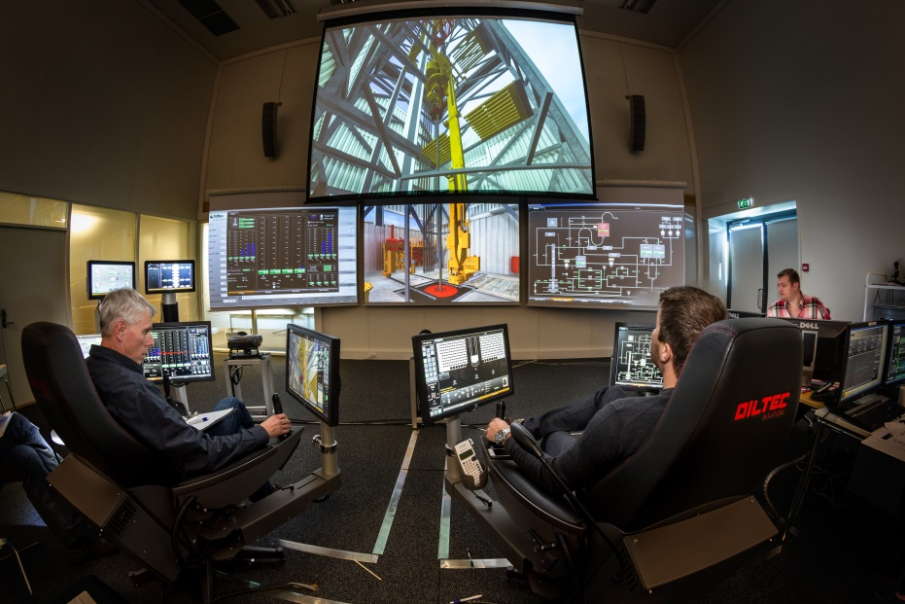
Slide 6
Drilling & Well - SINTEFs profile and role
R&D and advanced technical services within drilling, completion, well intervention and well integrity:
Drilling dynamics and mechanics
Hydraulics & Well Control
Special solutions: Managed Pressure Drilling and Dual Gradient Drilling
Monitoring & Control
Well Integrity
Well abandonment (P&A)
Drilling and well for CO₂ storage
Drilling and well for geothermal energy
Example commercialized products; SINTEFs spin-off company eDrilling Solutions provide services for drilling and well simulator training and well planning.

Slide 7
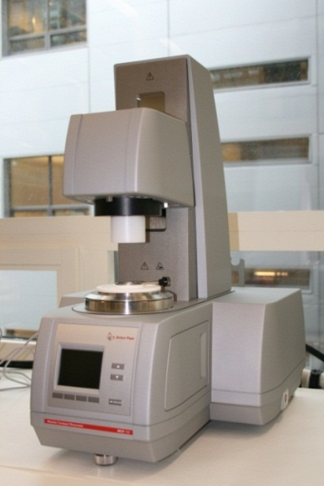
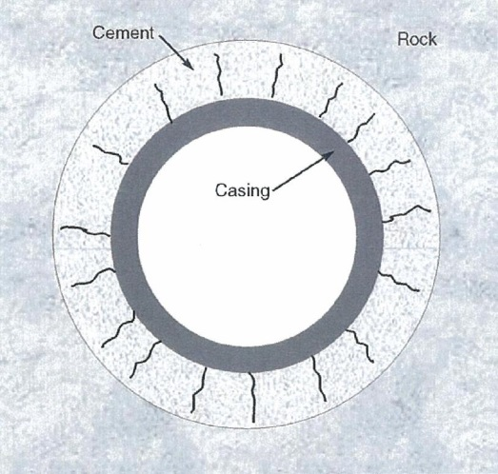
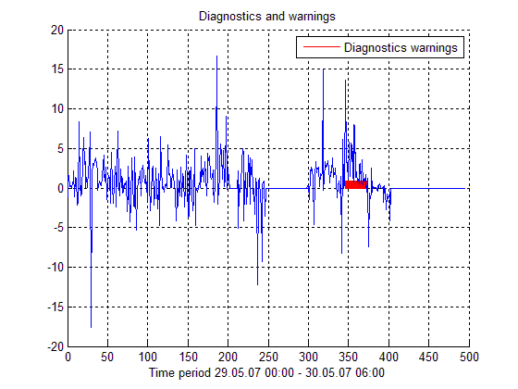
Activities, examples
Characterization of:
Drilling fluids
Crude oil
Cement
Emulsions
Polymer solutions
Other fluids
Life-cycle well integrity
: Managed Pressure drilling with drill string twist-off
!
Integrated drilling simulator
Advanced interpretation of drilling data
Notes:
Life-cycle well integrity: The objective is to ensure well integrity throughout the life-cycle of the well.
Two main focus areas:
Well barriers: Why do well barriers fail?
Well design: To optimize well design with a life-cycle well integrity perspective in mind
Integrated drilling simulator: The heart of both the eDrilling system and the training simulator for drilling operations. IDS is a synthesis of multiple transient and steady state coupled models for the drilling sub-processes. It simulates interactions between the various sub-processes. At present the IDS consists of a dynamic flow and temperature model, a torque and drag model, a rate of penetration (ROP) model, a wellbore stability model, and a pore pressure model.
Advanced interpretation of drilling data: Advanced signal processing methods are used to detect upcoming problems at an early stage. As an example, poor hole cleaning can be detected by using time series prediction methods. Poor hole cleaning may result in low drilling efficiency, stuck pipe, problems with well control or even a loss of the wellbore. (The figure shows the output of an algorithm for early detection of poor hole cleaning. The algorithm gave warnings a couple of hours before the pipe got stuck. If the algortihm had been used during the operation this problem could have been avoided.)

Slide 8
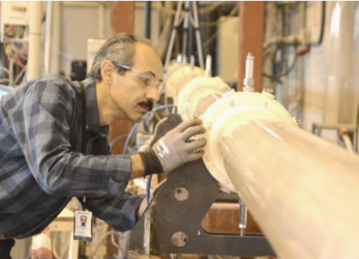
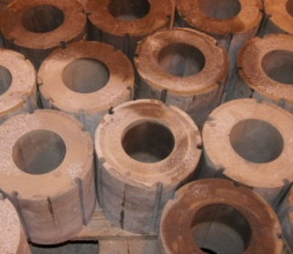
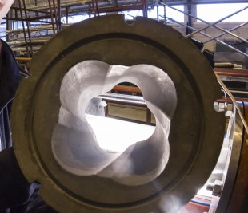
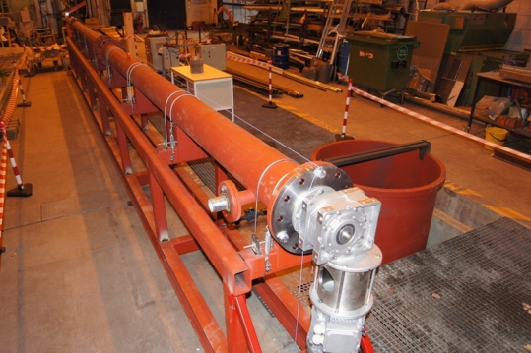
Key experimental facilities I; hole cleaning loop
Interchangeable modules enable variations in wellbore diameter or geometry
Borehole flow loop for investigating hydraulic and friction issues behind drill bit
12 m long, can be tilted to 30°
Rotating steel string
Compatible with any fluid system and any cutting type
Measure pressure drop, torque, axial force and cuttings bed
Performance testing of different drilling fluids.
Window for visual inspection or video

Slide 9
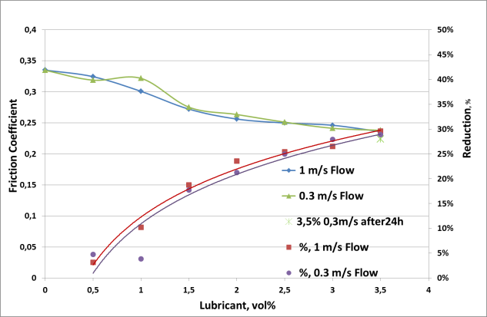
Example 1: Lubricant added to drilling fluid
Motivation: Stuck pipe avoidance
Friction vs. lubricant concentration at constant drilling string rotation
Impact from lubricant concentration
Type of drilling fluid; OBM/WBM
Drilling fluid flowrate
Friction factor calculated from measured torque
Parameter: Drilling string rotation

Slide 10
Example 2: Cuttings transport efficiency
Motivation: Stuck pipe avoidance
Cuttings hold-up vs. drilling fluid velocity in annulus
Impact from drilling fluid flowrate
Type of drilling fluid; here OBM/WBM
Drilling string rotation
Cuttings content calculated from mass distribution/ load cells

Slide 11
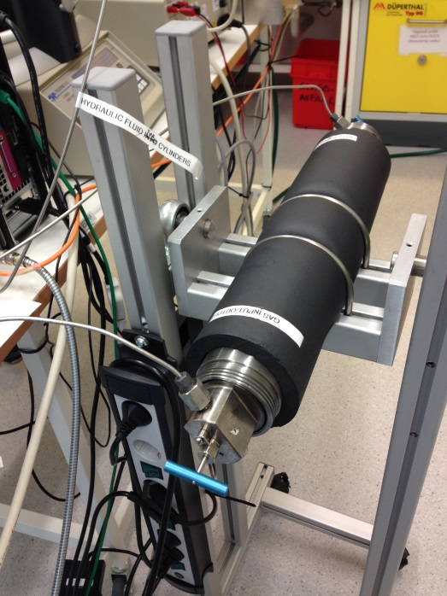
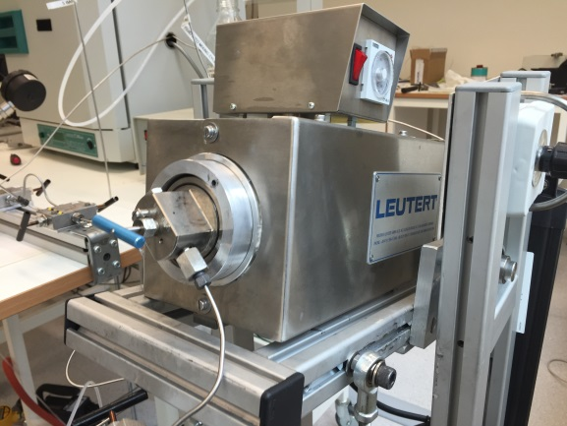
Slide 11
Key experimental facilities II; rheology characterisation of gas saturated drilling fluids
Motivation: Reduce potentially large uncertainties in calculated bottom hole pressure, volume changes, and timing of gas flow rate to surface

Slide 12
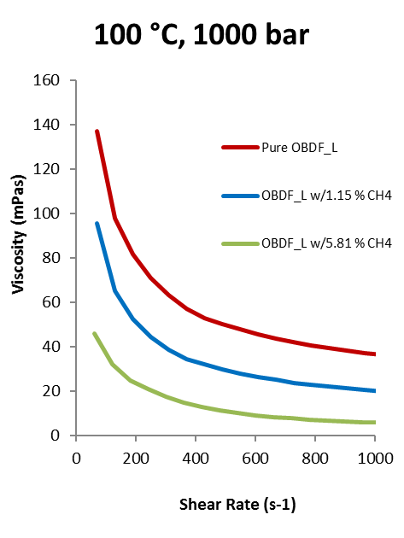
Slide 12
Example 1: Gas influx into drillling fluid, impact on viscosity
Motivation:
Diagnosis of downhole pressure annulus pressure, risk for accelerated particle sagging
Viscosity decreases with increasing gas amounts
(methane loading as approach to equilibrium %)

Slide 13
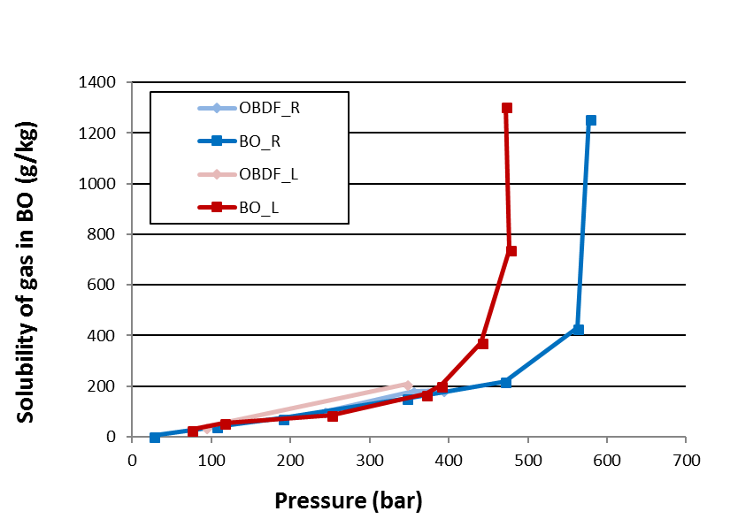
Example 2: Gas solubility and dense phase occurrence of drilling fluid-gas mixtures
Motivation:
Kick Detection Capability of Oil-based Muds in Well Control Situations
Henrys law loading characteristics until dense phase region is approached
SPE-180039-MS• Kick Detection Capability of Oil-based Muds in Well Control Situations • H. Linga
Notes:
Difference in density -> same %mass equals more CH4 absorbed in Sipdrill than EDC.

Slide 14
Slide 14
Content
Motivation & technology needs for drilling&well operations
Key features for drilling as a multiphase flow operation
Drilling & Well - SINTEFs profile and role
Selected projects, deliverables and results
Future topics

Slide 15
Future topics
Particle sagging occurrence
Cutting transport performance
Gas – drilling fluid interaction
kinetics (influx and degassing)
rheology
thermodynamics /phase envelope
Interpretation of along-string-measurements
Hybrid analytics/machine learning
Digitalisation
Automated operations based on real-time downhole process condition diagnosis
Q_{IN}
Drilling fluid COMPOSITION
Q_{OUT}
MULTIPLE FLUIDS
HYDRATE
DENSITY(p,T,i)
MULTI PHASE FLOW
RHEOLOGY(p,T,i)
PHASE/PVT PROPERTIES drilling fluid/GAS/OIL/CONDENSATE
THERMOPHYSICAL PROPERTIES
CUTTINGS TRANSPORT
Q_{LOSS}
DYNAMIC INFLUX Q_{RESERVOIR}
Colour legend:
RED: Real Time model RED & BLUE: Planning model VIOLET: Under development/Future
PARTICLE SAGGING
GAS DISSOLUTION in drilling fluid
DIFFUSION
Notes:
Colour of text distinguishes features that are available in real time and offline versions of the model, and features still not finished
Density and rheology are dependent on pressure, temperature, and fluid number (i)
Transient drilling operations means that model accounts for continuously changing pump rate, rotation rate, bit position, etc

