Slide 1






Experimental study of energy efficiency of CO2 hydrate slurry in a coil heat exchanger
Laurence FOURNAISON,
Thomas Dufour(PhD), Hong Minh HOANG, Véronique OSSWALD, Jérémy OIGNET, Pascal CLAIN,, Anthony DELAHAYE,

Slide 2

Aim and context
Cold production:
    17 % of world energy consumption
    8 % GES:
Prospection:
Increase of efficiency
Reduction of refrigerant use
F-GAS regulation

Slide 3
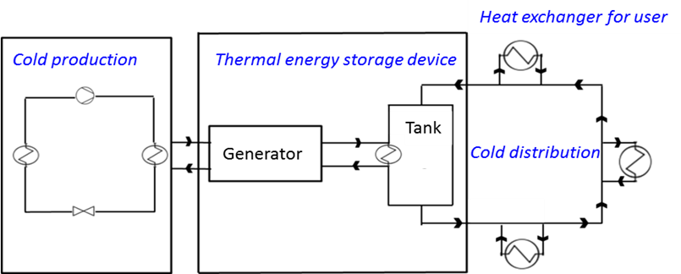
Aim and context
Secondary refrigeration with thermal energy storage
Terminal unit : Heat exchanger
Dissociation, Heat release, Efficiency?

Slide 4
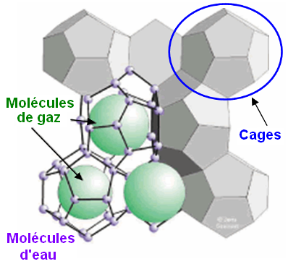
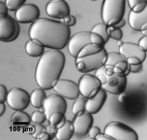
CO₂ hydrate slurry
Latent heat : 374 kJ/kg
Hydrate domain : 272 K to 284 K
Pressure : 10 to 45 b
CO₂ hydrate
  Excès de CO₂
  Ice slurry
  (Stamatiou et al., 2005)

Slide 5
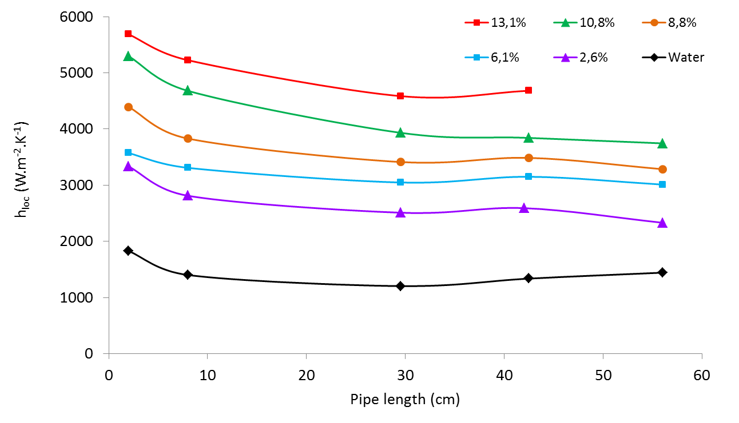
Heat exchange with hydrate slurry
Heat transfer coefficient : > 2 times pure water
Design of the heat exchanger:
Reduce length when increasing solid fraction
Higher ice content increase viscosity
Optimization: Solid content versus tube length

Slide 6
Experimental device and protocol

Slide 7
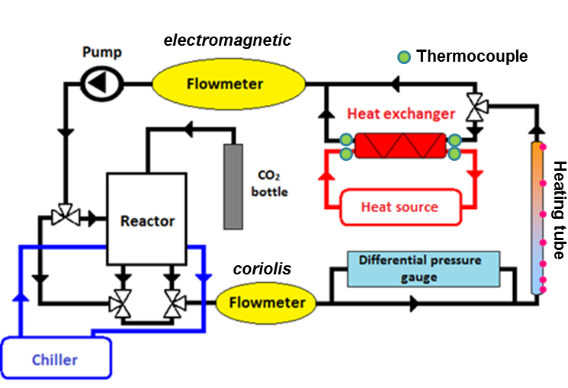
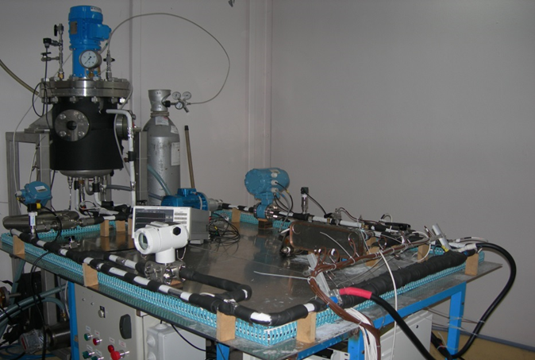
Experimental device
Mass flow
Temperature
Pressure
Viscosity : capillary viscosimeter
Heat transfer coefficient : heating tube

Slide 8
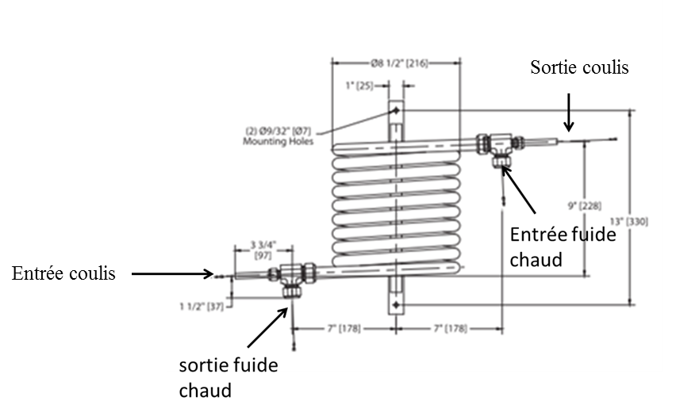
The heat exchanger
Hot water
Slurry
D_{in} : 7,7 mm
D_{ex} : 9,5 mm
4 thermocouples :
Inlet/outlet water, slurry
Counter flow heat exchanger

Slide 9
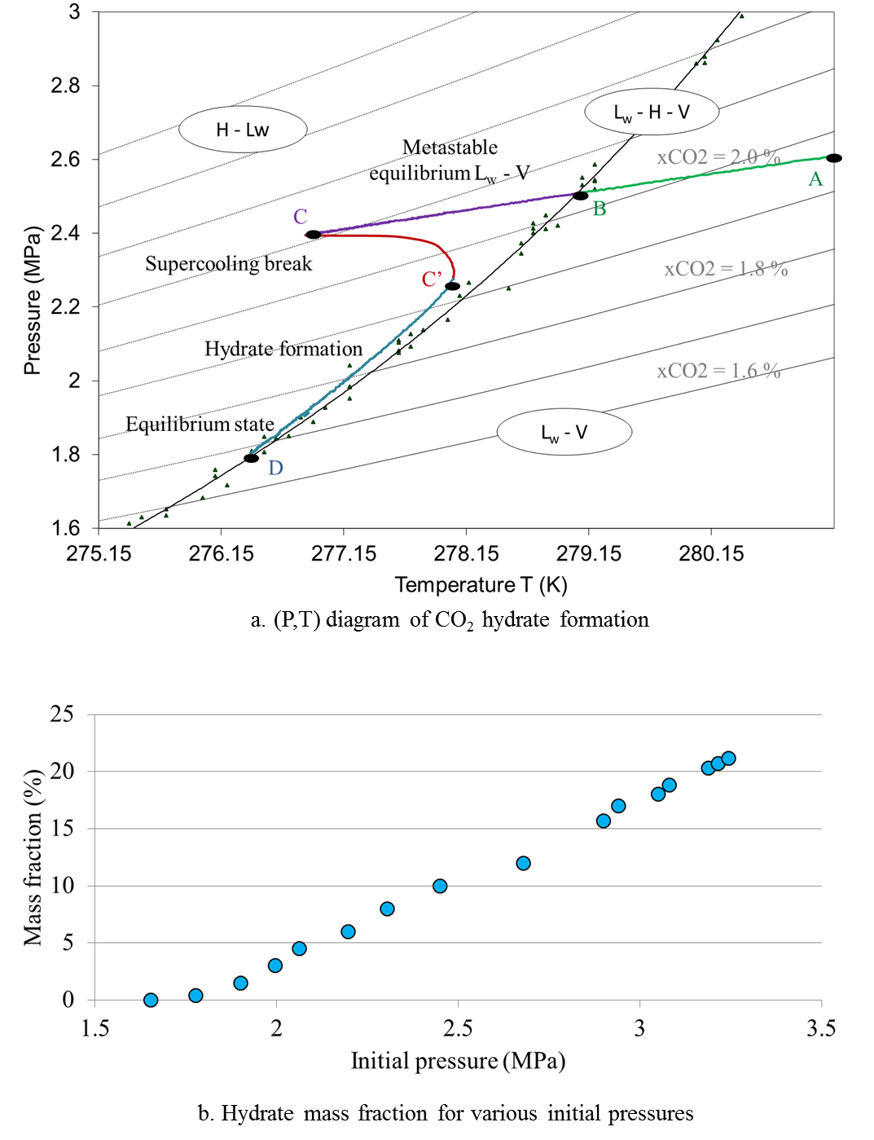
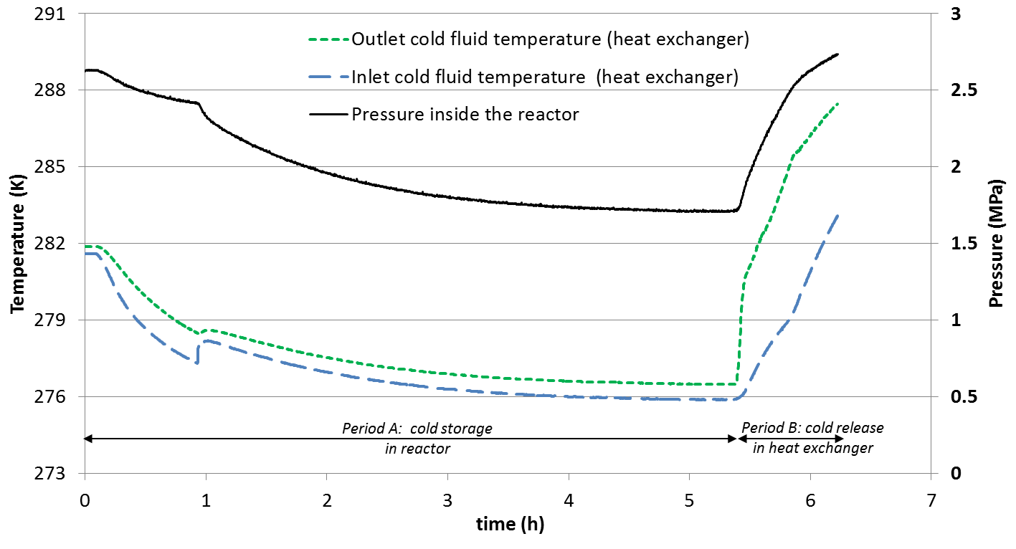
Protocol
P: 27 bar,
T_{hot}:293 K;
wt: 12%

Slide 10
Hydrate content
In house software: wt = f(T, P, x_{gas})
wt increase higher energy available, higher heat transfer coefficient +
higher viscosity -

Slide 11
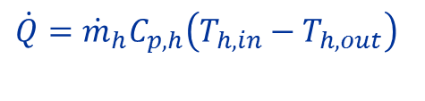
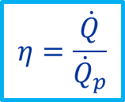
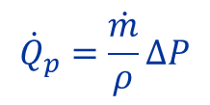
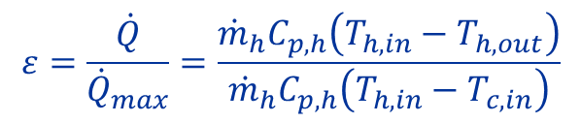
Energy release and pressure drop
Hot water side:
$\dot{Q}={\dot{m}}_{h}C_{p,h}\left(T_{h,in}−T_{h,out}\right)$
Slurry side:
$${\dot{Q}}_{}={\dot{m}}_{c}\int_{T_{c,in}}^{T_{c,out}}{{c_{p}}_{hs}dT}+{\dot{m}}_{c}wt L={\dot{m}}_{c}\int_{T_{c,in}}^{T_{c,out}}{\left({C_{p}}_{hyd}∙wt+{C_{p}}_{liq}∙(1−wt)\right)dT+{\dot{m}}_{c}wt L}$$
Heat Exchanger efficiency
Pumping power
$$ε=\frac{\dot{Q}}{{\dot{Q}}_{max}}=\frac{{\dot{m}}_{h}C_{p,h}\left(T_{h,in}−T_{h,out}\right)}{{\dot{m}}_{h}C_{p,h}\left(T_{h,in}−T_{c,in}\right)}$$
$${\dot{Q}}_{p}=\frac{\dot{m}}{ρ}∆P$$
Global performance efficiency
$$η=\frac{\dot{Q}}{{\dot{Q}}_{p}}$$

Slide 12
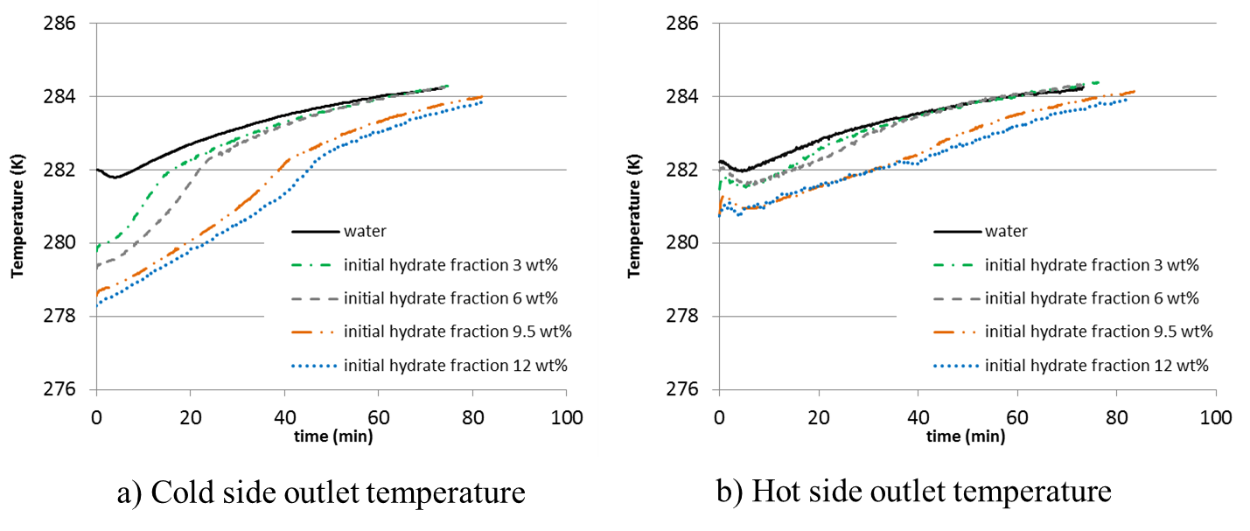
Experimental results
Hydrate Flowrate: up to 160 kg.h⁻¹, x_{hyd}: 0 to 12 %
Hot Fluid Temperature: 283-293 K ; 58 kg.h⁻¹

Slide 13
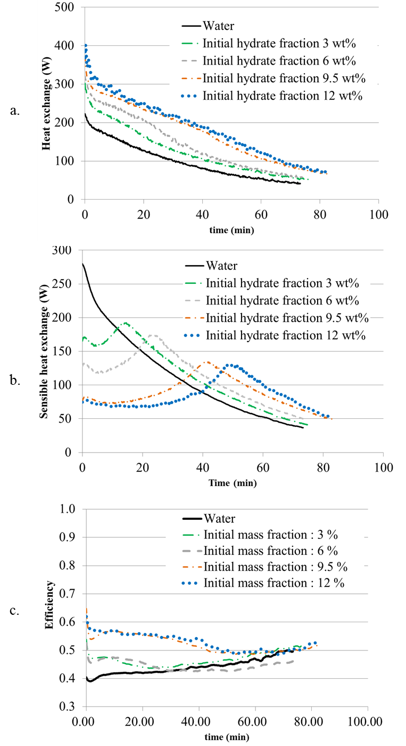
Heat exchanger performance
Higher efficiency with slurry

Slide 14
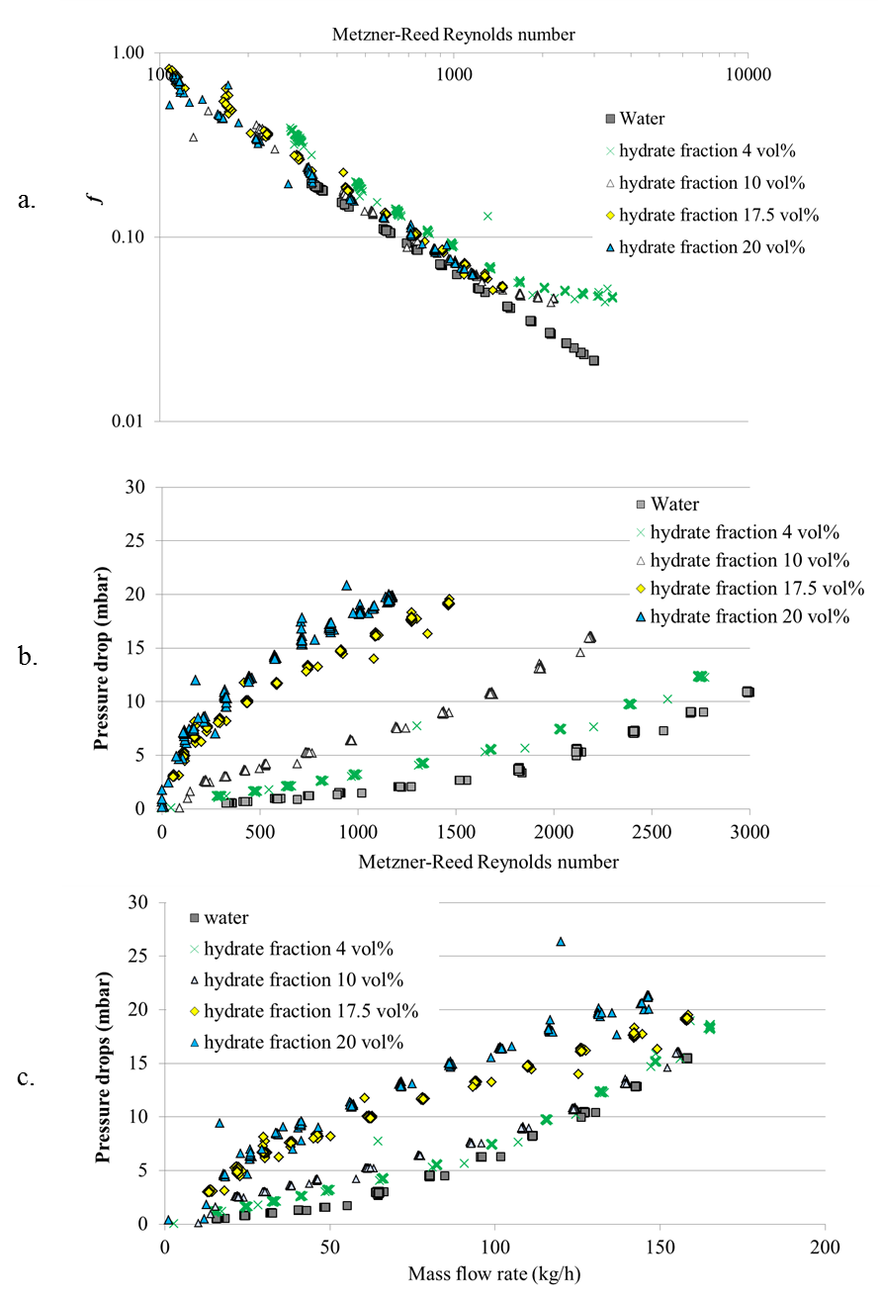
Pressure drop
Pressure drop increases with mass flow rate and solid fraction

Slide 15
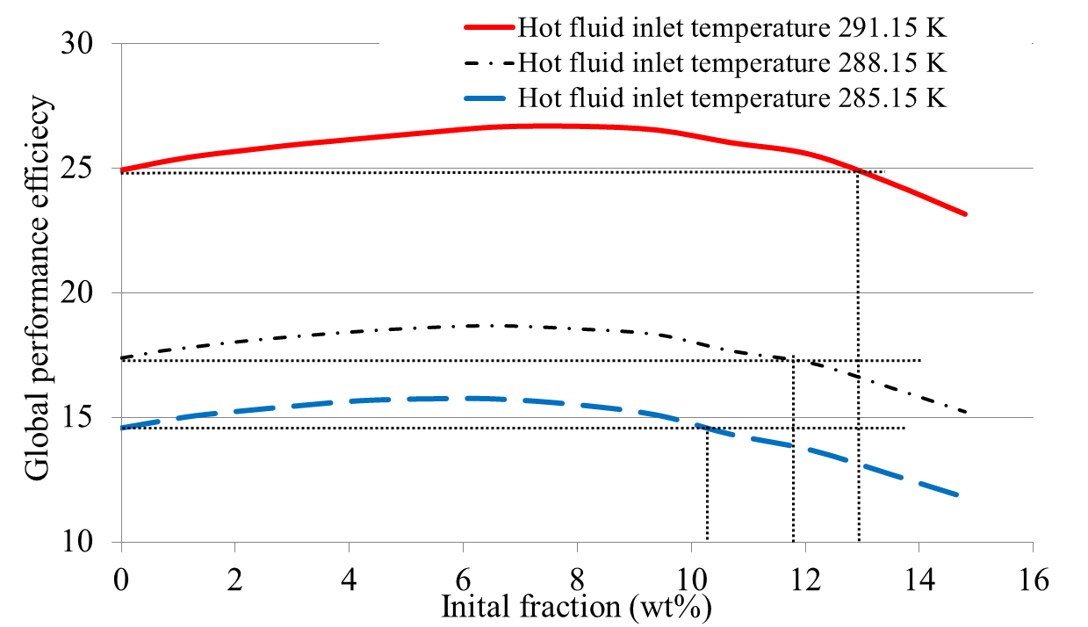

Global performance of the heat exchanger
$$η=\frac{\dot{Q}}{{\dot{Q}}_{p}}$$
Higher performance with: hot fluid
12 % solid fraction

Slide 16
Conclusions
Hydrates enhance the heat exchange thanks to the increase of the temperature difference between cold and hot fluids provided by hydrate melting
While an increase of the pressure drop was observed for slurry due to a higher viscosity, it was possible to obtain a lower pressure drop than water by reducing the slurry flowrate
Hydrate slurry provides better efficiency than water since the increase in heat exchange overcomes the pumping power rise
Optimal solid fraction is found between 5 and 8 wt%; the optimal value shifted to higher fraction for higher power demand
Issue concerning hydrate dissociation

Slide 17

Thank you for your attention
Experimental and modelling study of energy efficiency of CO ₂ hydrate slurry in a coil heat exchanger
Dufour, T., Hoa,g,H.M., Oignet, J., Osswald, V., Fournaison, L., Delahaye, A.
Applied Energy, Volume 242, 15 May 2019, Pages 492-505
Projet Crisalhyd

