Slide 1




PIRE Project: Multi-scale, Multi-phase Phenomena in Complex Fluids for the Energy Industries thrust III: Drilling Fluids and Mechanisms of Particle Sedimentation Manizheh Ansari (PhD), Dinesh Kalaga (Post-Doc)
Masahiro Kawaji, Sanjoy Banerjee, Jeffrey Morris
June 18, 2018
The City University of New York
City College of New York
Energy Institute

Slide 2
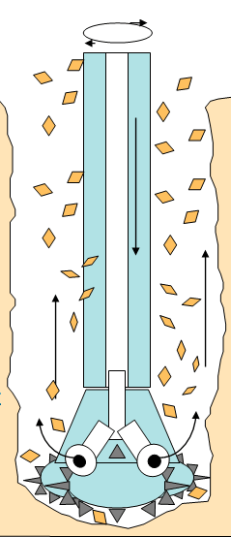
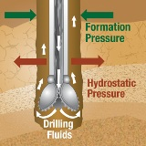
thrust III: Drilling Fluids and Mechanisms of Particle Sedimentation
Drilling fluids functionalities:
Transporting cuttings to the surface, cooling and lubricating the bit and
drill string, providing well pressure control, maintaining wellbore stability,
and preventing formation damage by creating a filter cake sealing the rock pores.
Drilling Fluids Design criteria:
Non-Newtonian rheological properties
Shear-thinning, preferably with a yield stress.
Adjustable density
Adding a weight material
barite particles added to increase the density and thereby the downhole pressure
( hydrostatic pressure > formation fluid pressure)
Stability/Reproducibility
Properties should be stable over time
reproduce rheological measurements

Slide 3
Objective and motivation
Study of sedimentation of particles in non-Newtonian fluids.
Problem is undesirable settling of solid weight material particles in drilling fluids (aka Sag) causing lost circulation, a specified density difference relative to a stagnant drilling fluid causing pressure differences and fluid leakage through casing.
Characterization of DF with respect to settling rate of barite particles.
Addressing the effect of shear and mixing as well as individual components in the drilling fluids on the resulting fluid rheology
Design of DF which can stabilize barite particles (resistant to settling).
Hypotheses
Barite can be stabilized in OBDF by increasing the water content, keeping the water/emulsifier mass ratio constant
Difference in surface wetting properties of weighting agent cause differences in settling properties (sag response)
Compared with API barite, micronized barite is more dispersed, and has a better sag stability. Electrostatic repulsion and Brownian motion effect between micronized barite particles is significantly greater than API barite particles.
Increased temperature reduces the fluid viscosity and thereby increases the sedimentation rate.
By imposing shear to the fluid (e.g. higher string rotation) sedimentation rate increases.
Particle sedimentation characterization
Rheology, Sedimentation rate , Particle size distribution, and density measurements
X-ray methods
Gamma densitometry

Slide 4
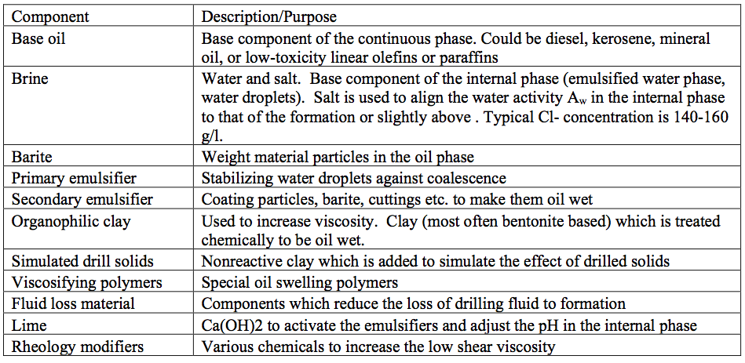

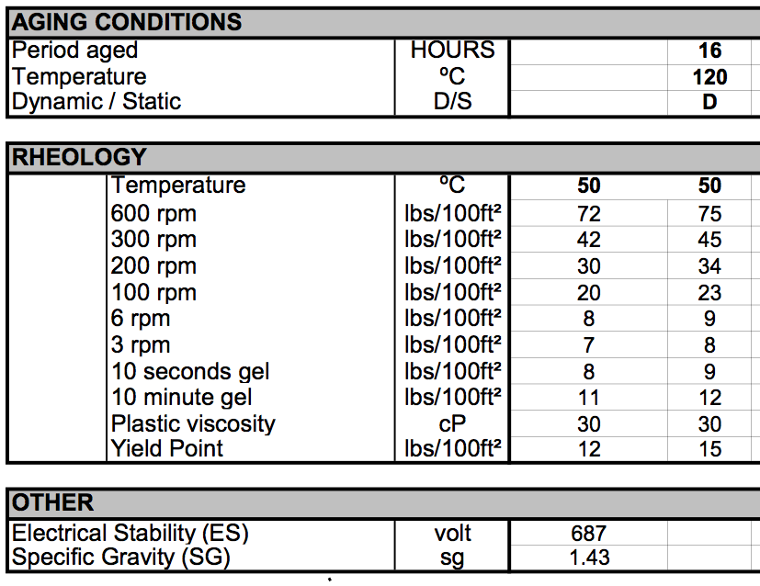
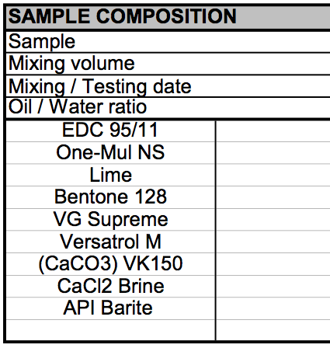
Proposed composition for the oil-based drilling fluid
One-Mul NS: Primary and secondary emulsifier
VG Supreme: Special organophilic clay, viscosifier
Versatrol M: Gilsonite (a naturally occurring asphalt) , fluid loss material
VK150: Simulated drill solids

Slide 5
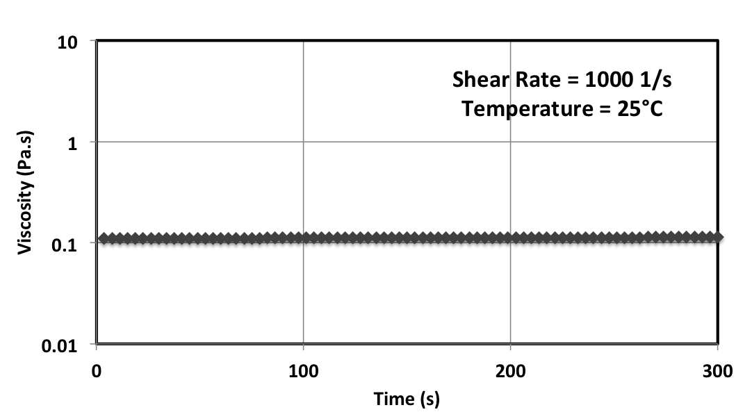
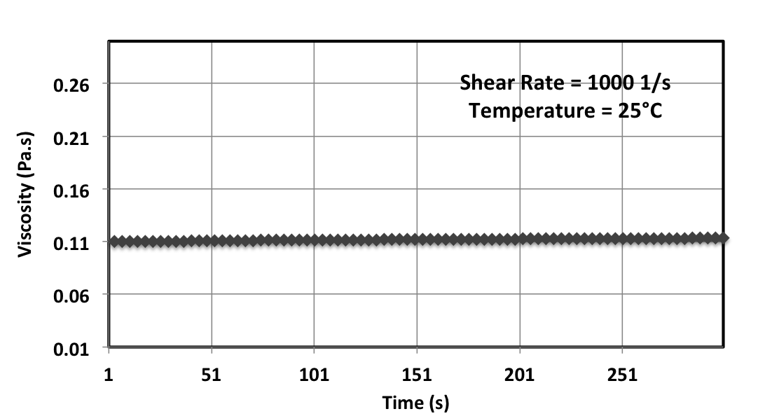
Rheology Measurements of the Model Drilling Fluid
Pre sheared for 10 mins
Pre sheared for 10 mins
Linear scale

Slide 6
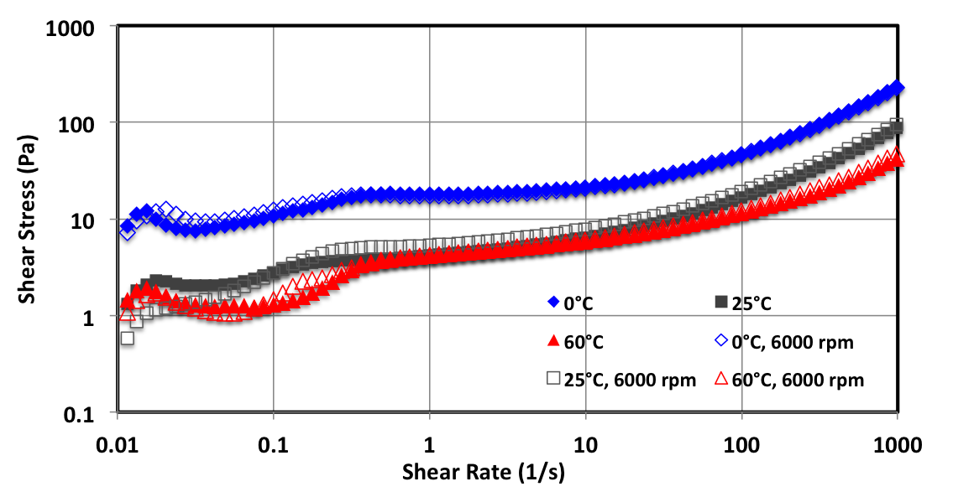
Two different regimes can be seen:
Newtonian behavior at low shear rate?
Herschell-Bulkley behavior (?) at higher shear rate (shear thinning).
Existence of yield stresses

Slide 7
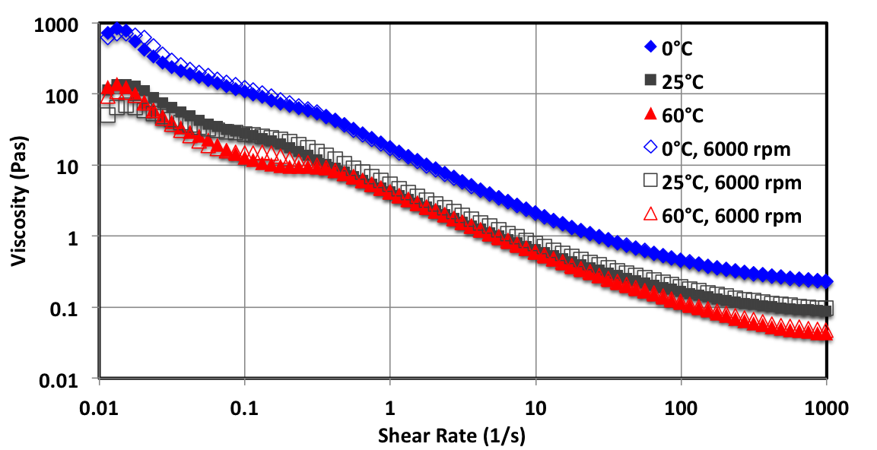
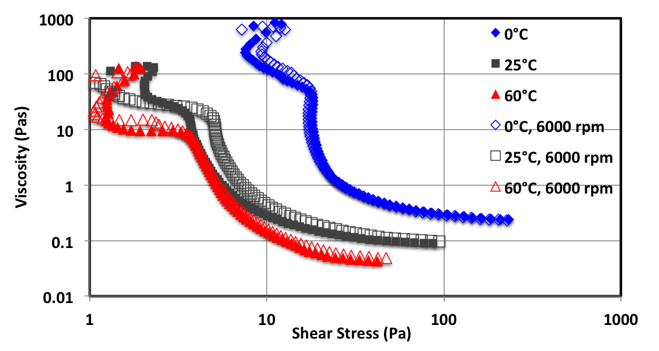

Slide 8
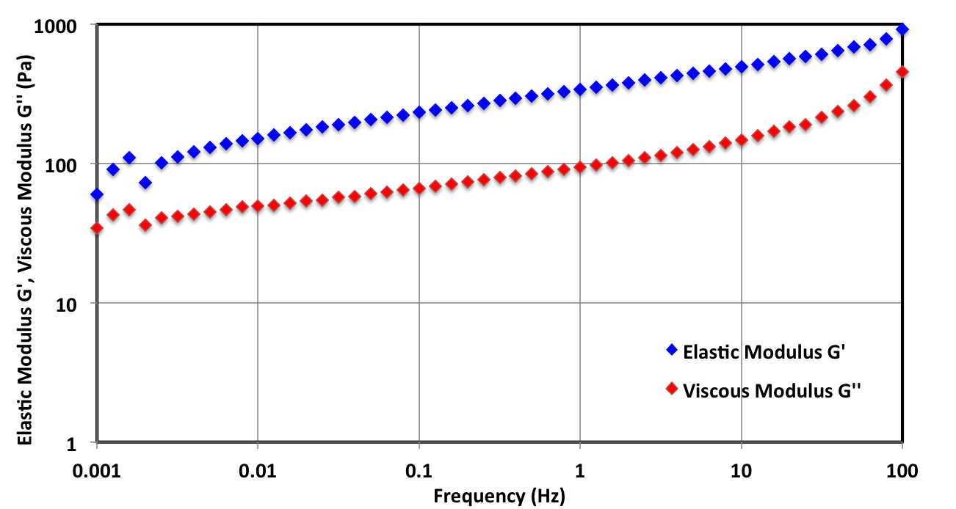
Viscoelastic properties of drilling fluid
Oscillatory rheometry measurements have confirmed the existence of different regimes??
Fluid behaves as a viscoelastic solid
Increase of frequency is favorable for the presence of elastic deformation and viscous performance
The mud develops a solid like structure with a predominantly elastic behavior, G’’/G’<1

Slide 9
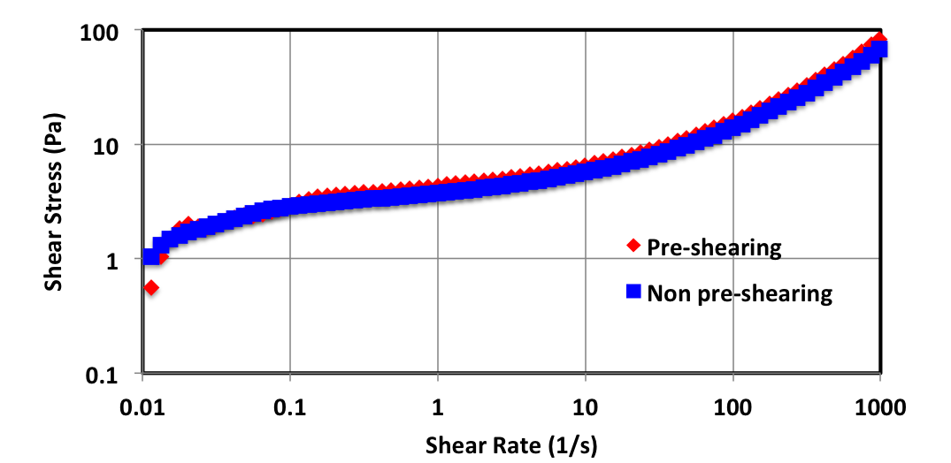
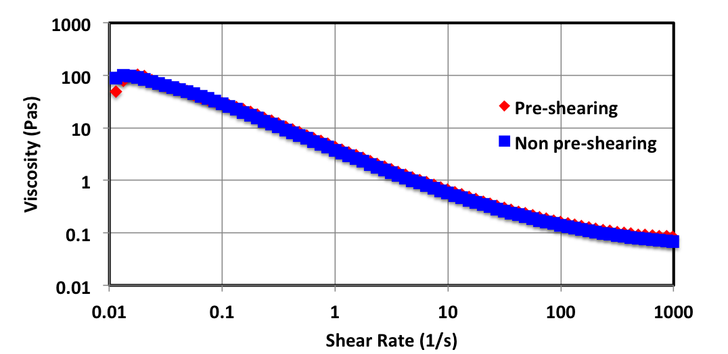
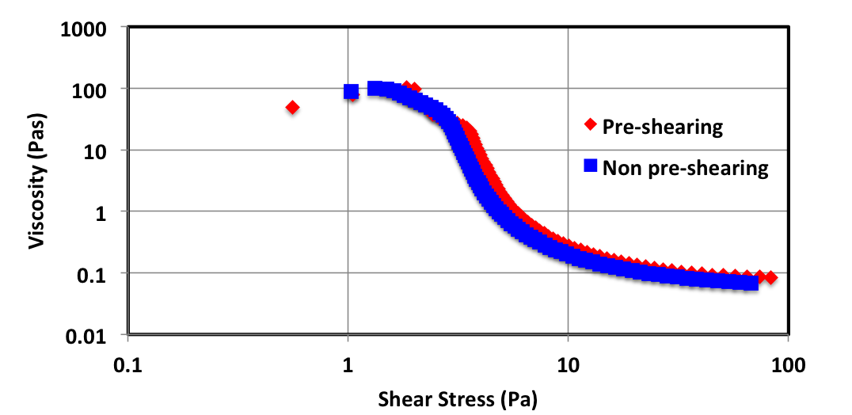
25°C
25°C
25°C

Slide 10
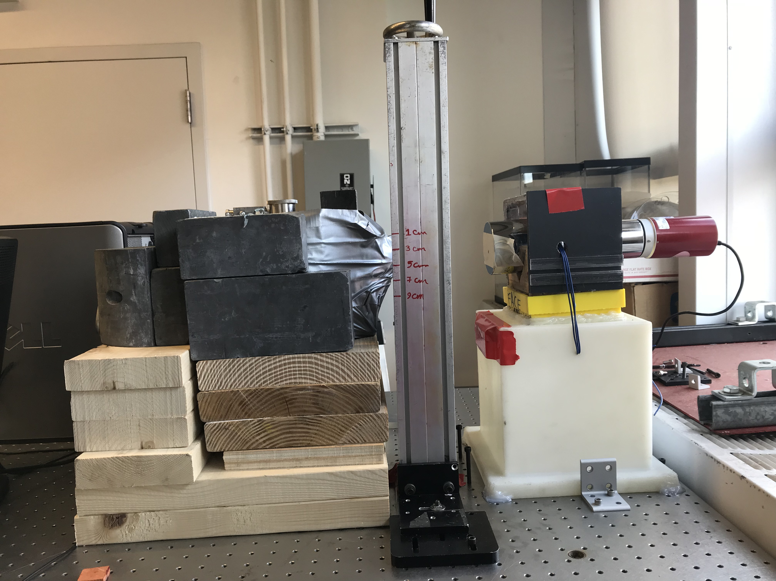
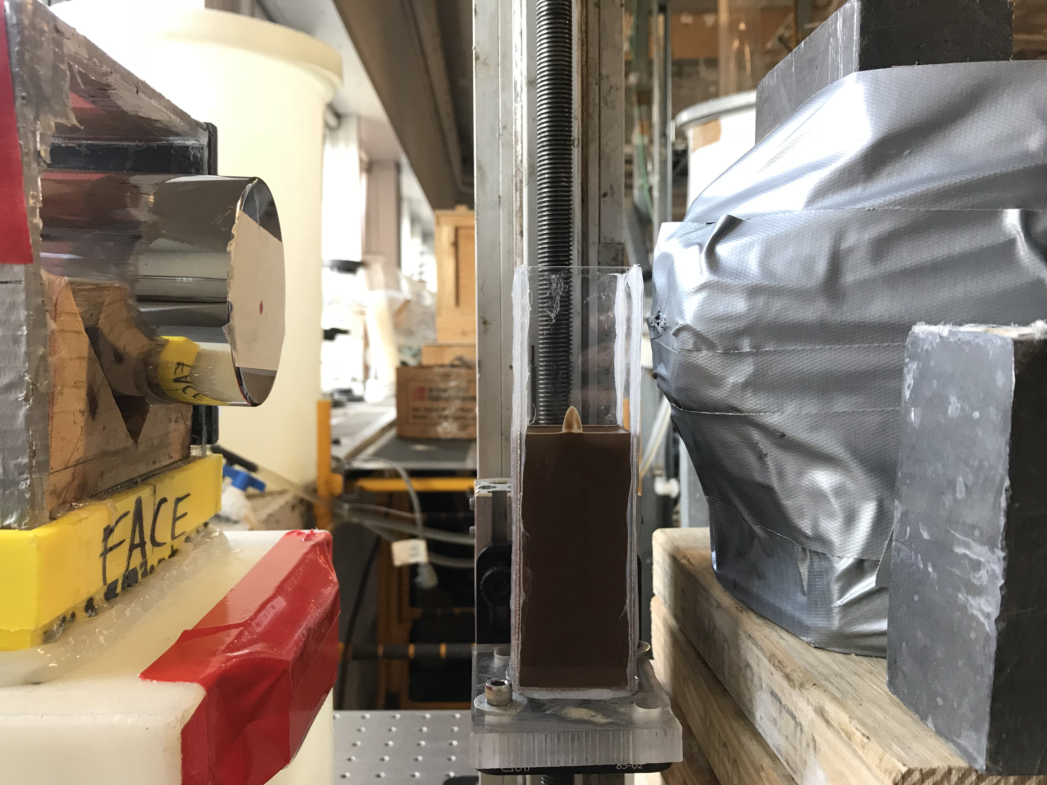
Gamma densitometry set-up
4-inches lead protection
Test section
5 mCi Cs-137 source
662 keV photons
Source
3”
Detector (NaI)
4 mm beam
Drilling mud

Slide 11

Fabrication of test section
Beer-Lambert Law
~ 0.5
I: gamma intensity
A: absorption coefficient (cm²/g)
ρ: density (g/cm³)
d: mud thickness ~ 4 cm
9cm
15 cm
7cm
5cm
Comp | Absptn Coef at 662 keV (cm2/g) | density (g/cm3) | Percent (%)
Barite | 0.075 | 4.2 | 15 | 0.116
Bentonite | -- | 1.6 | 1 | 0.01
oil | 0.38/0.1 | 0.8 | 60 | 0.562
Brine | 0.2/0.1 | 1.1 | 15 | 0.125
3cm
1cm
4 cm

Slide 12

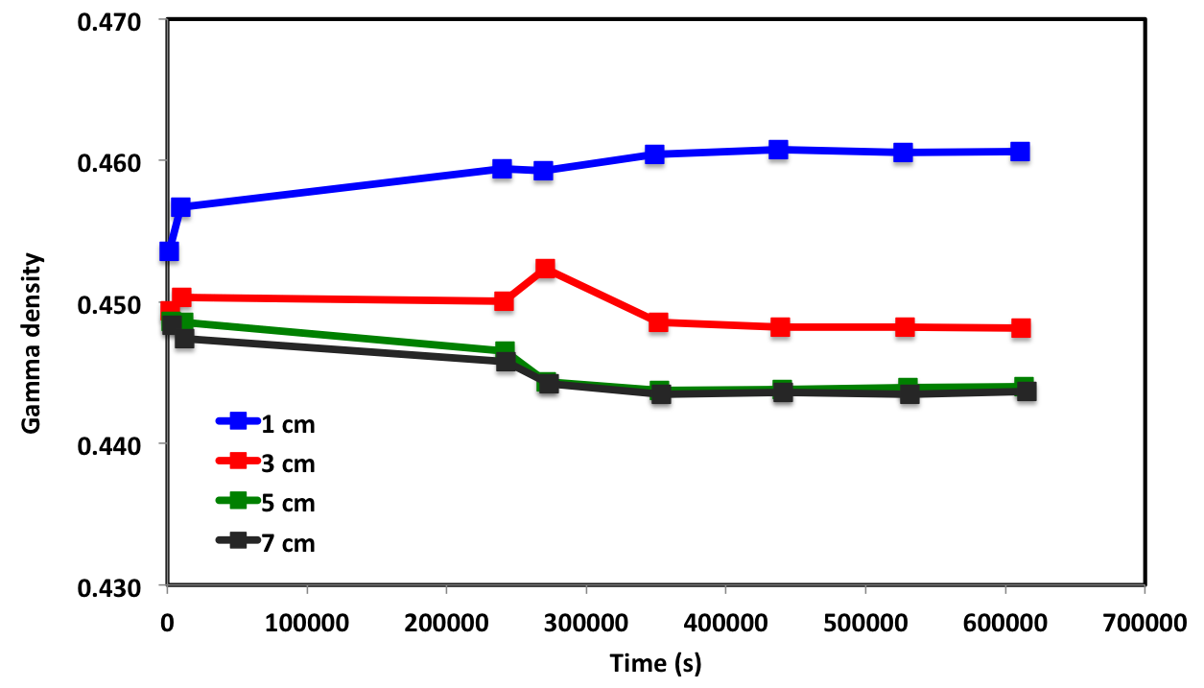
Gamma density measurements
~ 0.5
9cm
15 cm
7cm
5cm
3cm
1cm
4 cm
Distance between source and column < 1cm
Mud thickness ~ 4 cm
Error Propagation: Gamma density >+/- 0.002

Slide 13
Draft Slides

Slide 14
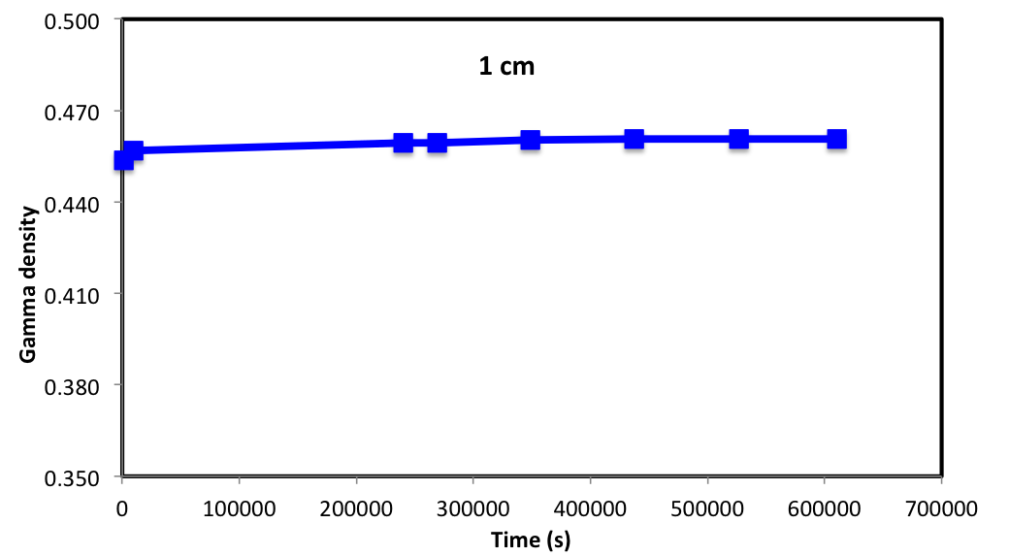
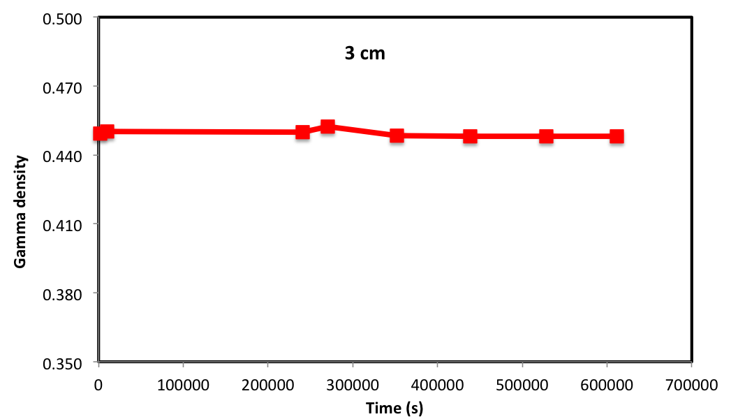
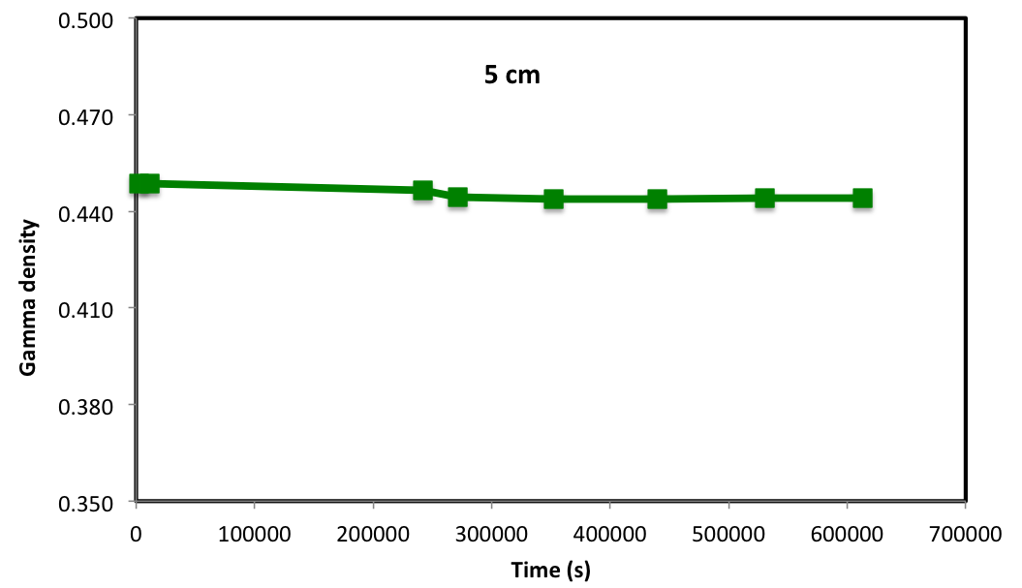
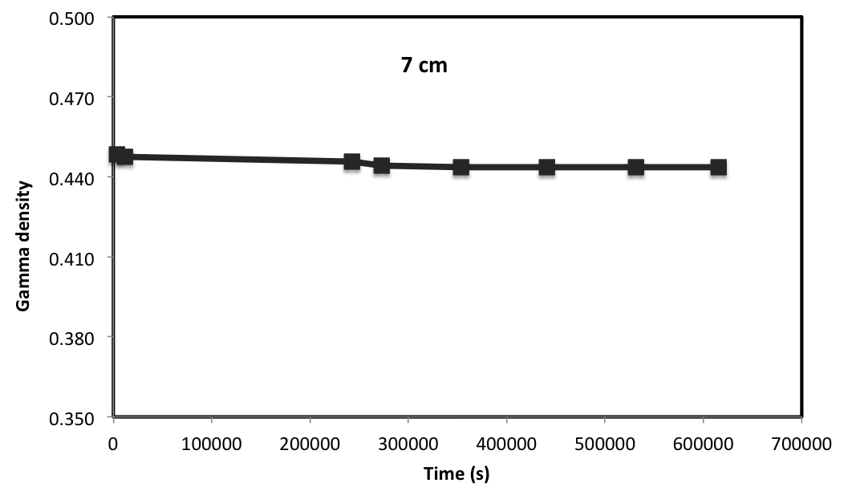

Slide 15
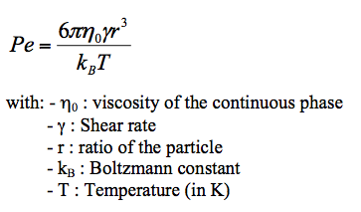
Presence of micronic clay and droplets in the mud formulation implies competition between two forces inside the fluid: brownian forces depending on the temperature and hydrodynamic forces depending on the applied shear rate.
Clays particles and emulsion droplets may be described as colloidal particles promoting an elastic structure at rest, shearing the mud sample destroys this structure when the shearing energy is superior to the colloidal energy.
Herzhaft et al., 2002

Slide 16
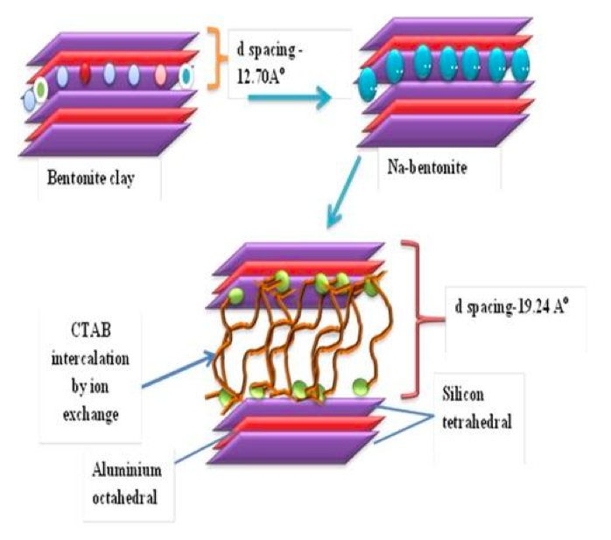
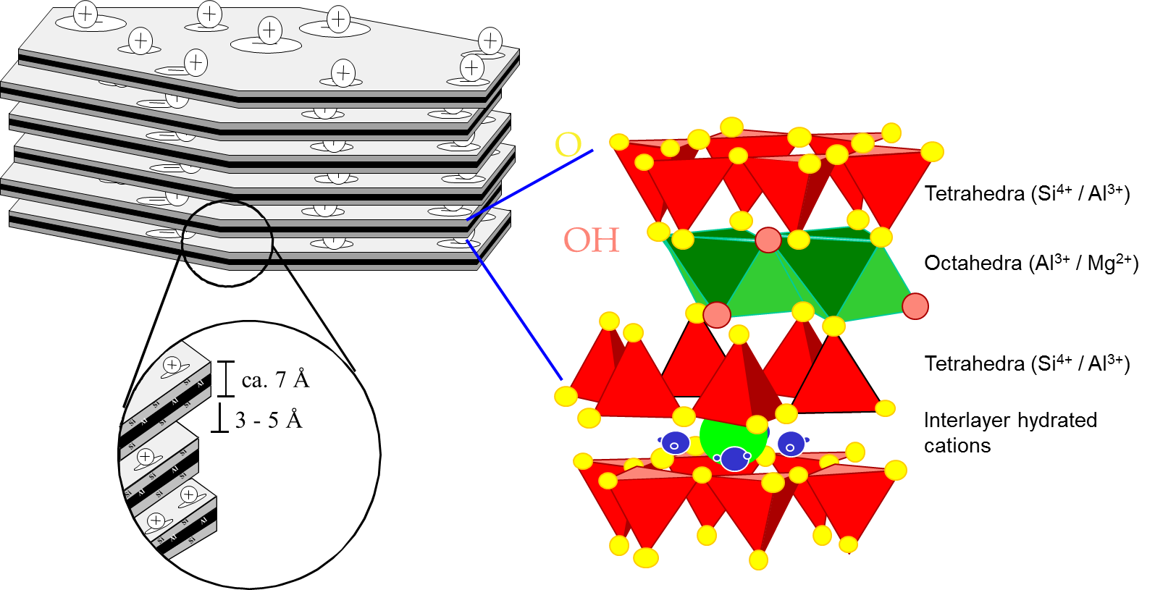
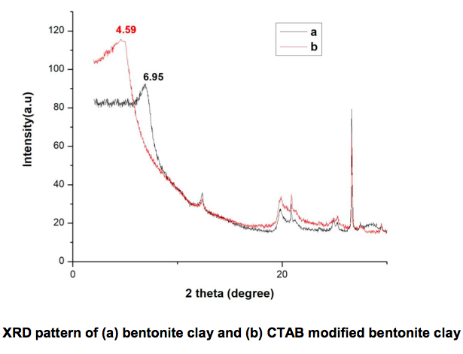
Structure of modified clay
A decrease in the 2 theta angle indicated an increase in interlayer spacing
Pandey et al., 2017

Slide 17
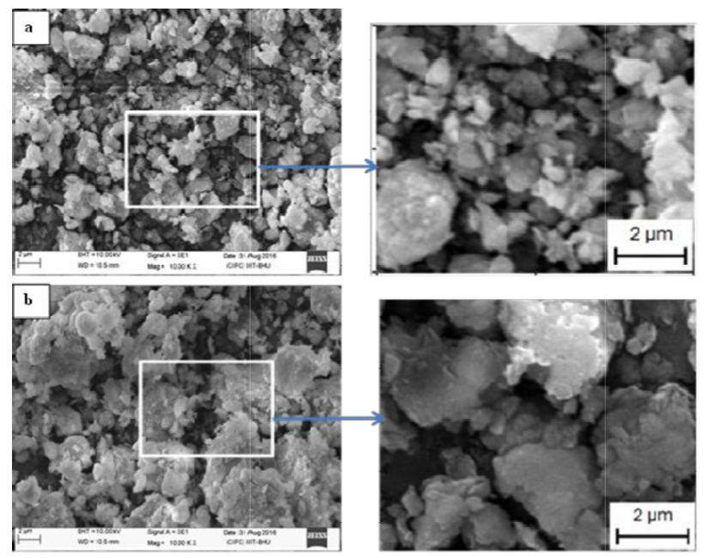
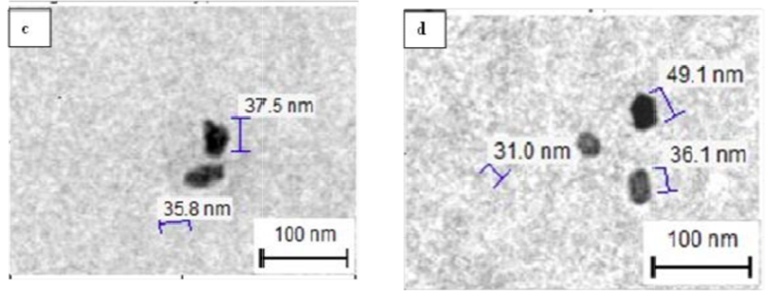
SEM image of Bentonite clay
CTAB bentonite
Bentonite
CTAB bentonite
TEM image
Pandey et al., 2017

Slide 18
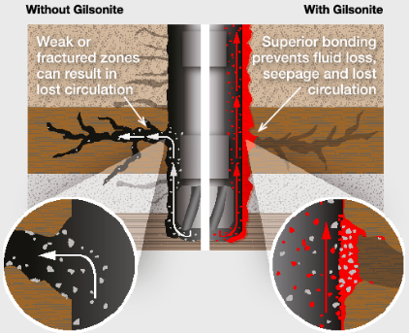
http://www.americangilsonite.com/index.php?id=20

Slide 19
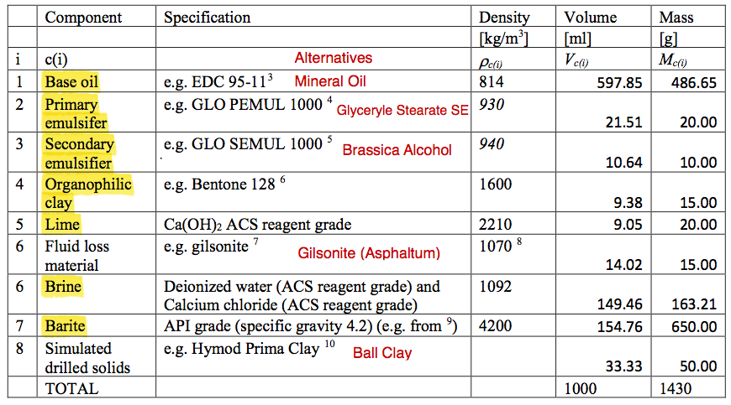
Proposed composition for the oil-based drilling fluid
Notes:
Kerosene is not recommended. It contains a significant fraction of aromatics. also Evaporation from a sample makes it more difficult to retain correct properties.
Aalternatives for emulsifiers. We have no knowledge that this will work. Finding a good composition of emulsifiers is a research task on its own.
Bentone 128 is bentonite treated with organic ions to make it oil-wetting rather than water-wetting. delivers rapid dispersion and has good sag resistance properties.

