Slide 1
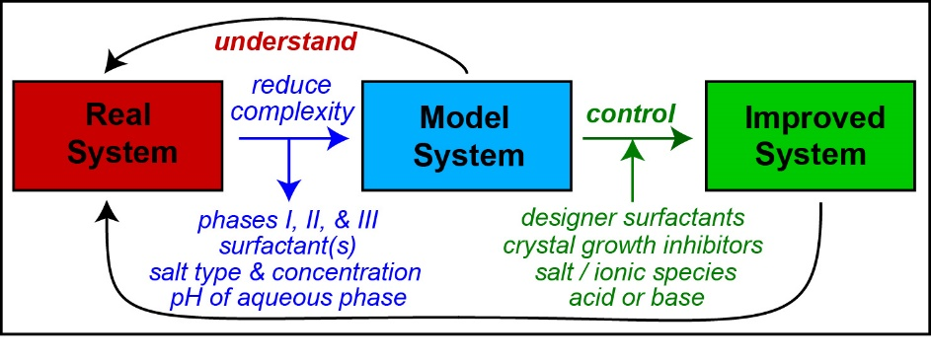
Overview of Modeling & Simulation Thrust
Long Term Objectives: Support other thrust areas by providing better and deeper understanding of model systems in Gas Hydrates, Drilling Fluids, PCM Nanoemulsion, Asphaltene thrusts
Current Objectives:
MD/DFTM (Molecular Dynamics/Density Functional based on Tight Bonding) simulations of Asphaltene molecules/clusters at water interface, and Gas Hydrates
MD/Continuum (Boundary Integral & Lattice Boltzmann methods) simulations of drops and particles under electric field with potential applications in Drilling Fluids
Continuum modeling/simulations of spreading drop on fiber and particles at oil/water interface with potential applications in Nanoemulsion, Drilling Fluids, and Gas Hydrates
Identify multiscale modeling strategies

